Slide 1

Toyota Highlander

Slide 2

INTERIOR DESIGN

Slide 3
INTERIOR DESIGN

Slide 4
DASHBOARD

Slide 5
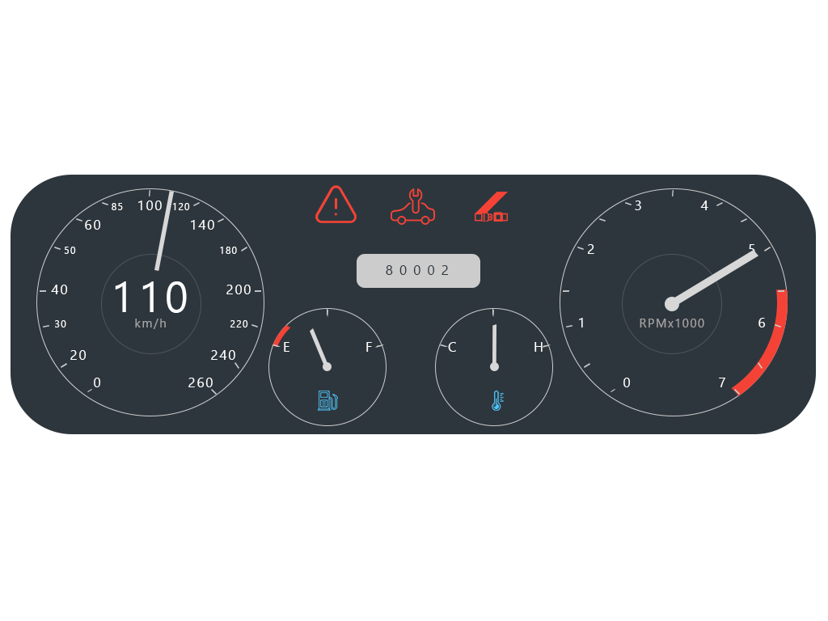
DASHBOARD

Slide 6
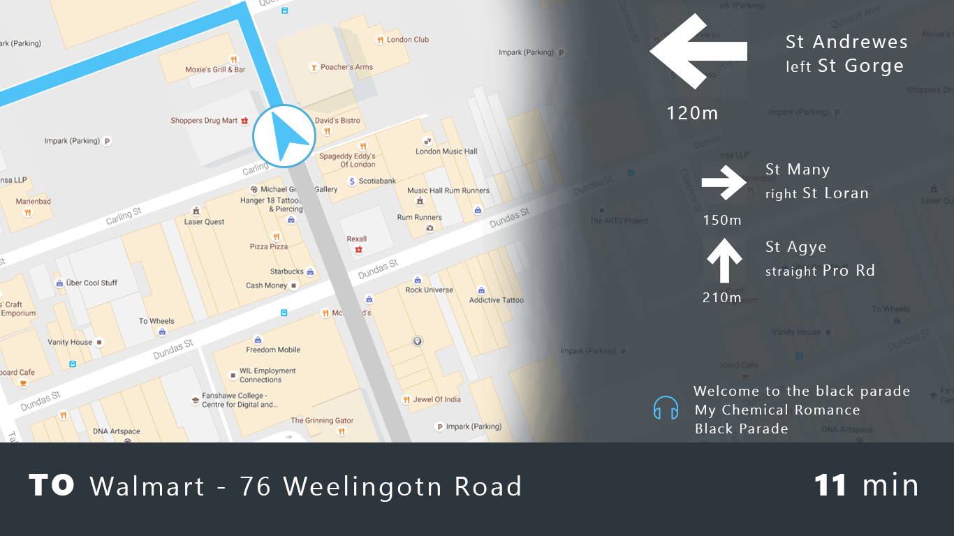
DASHBOARD

Slide 7
PANEL

Slide 8
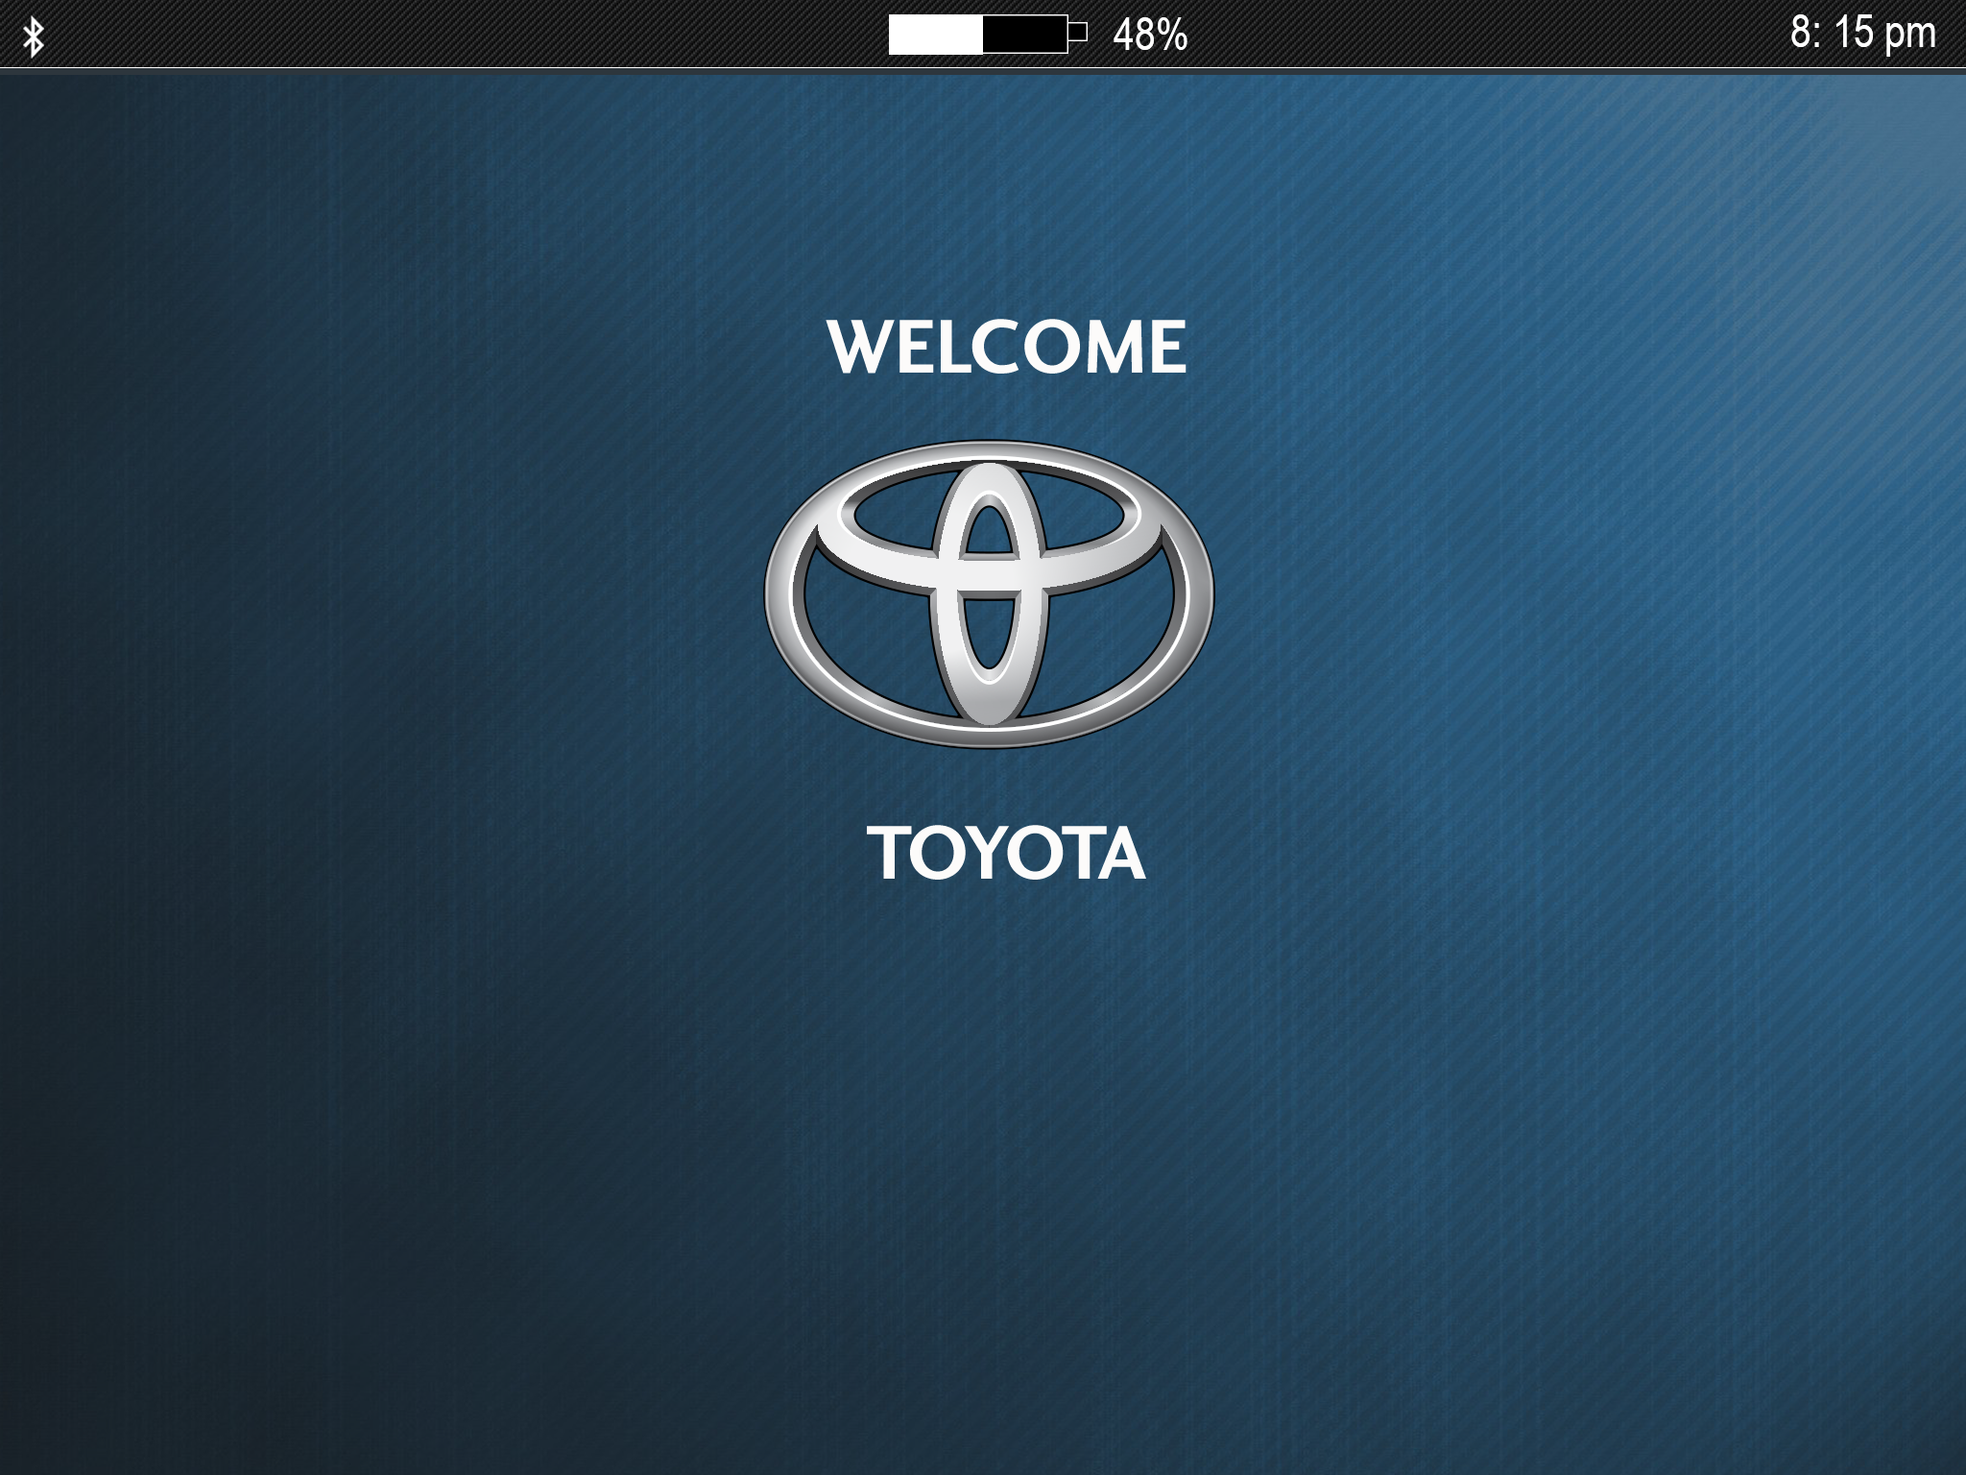

Slide 9
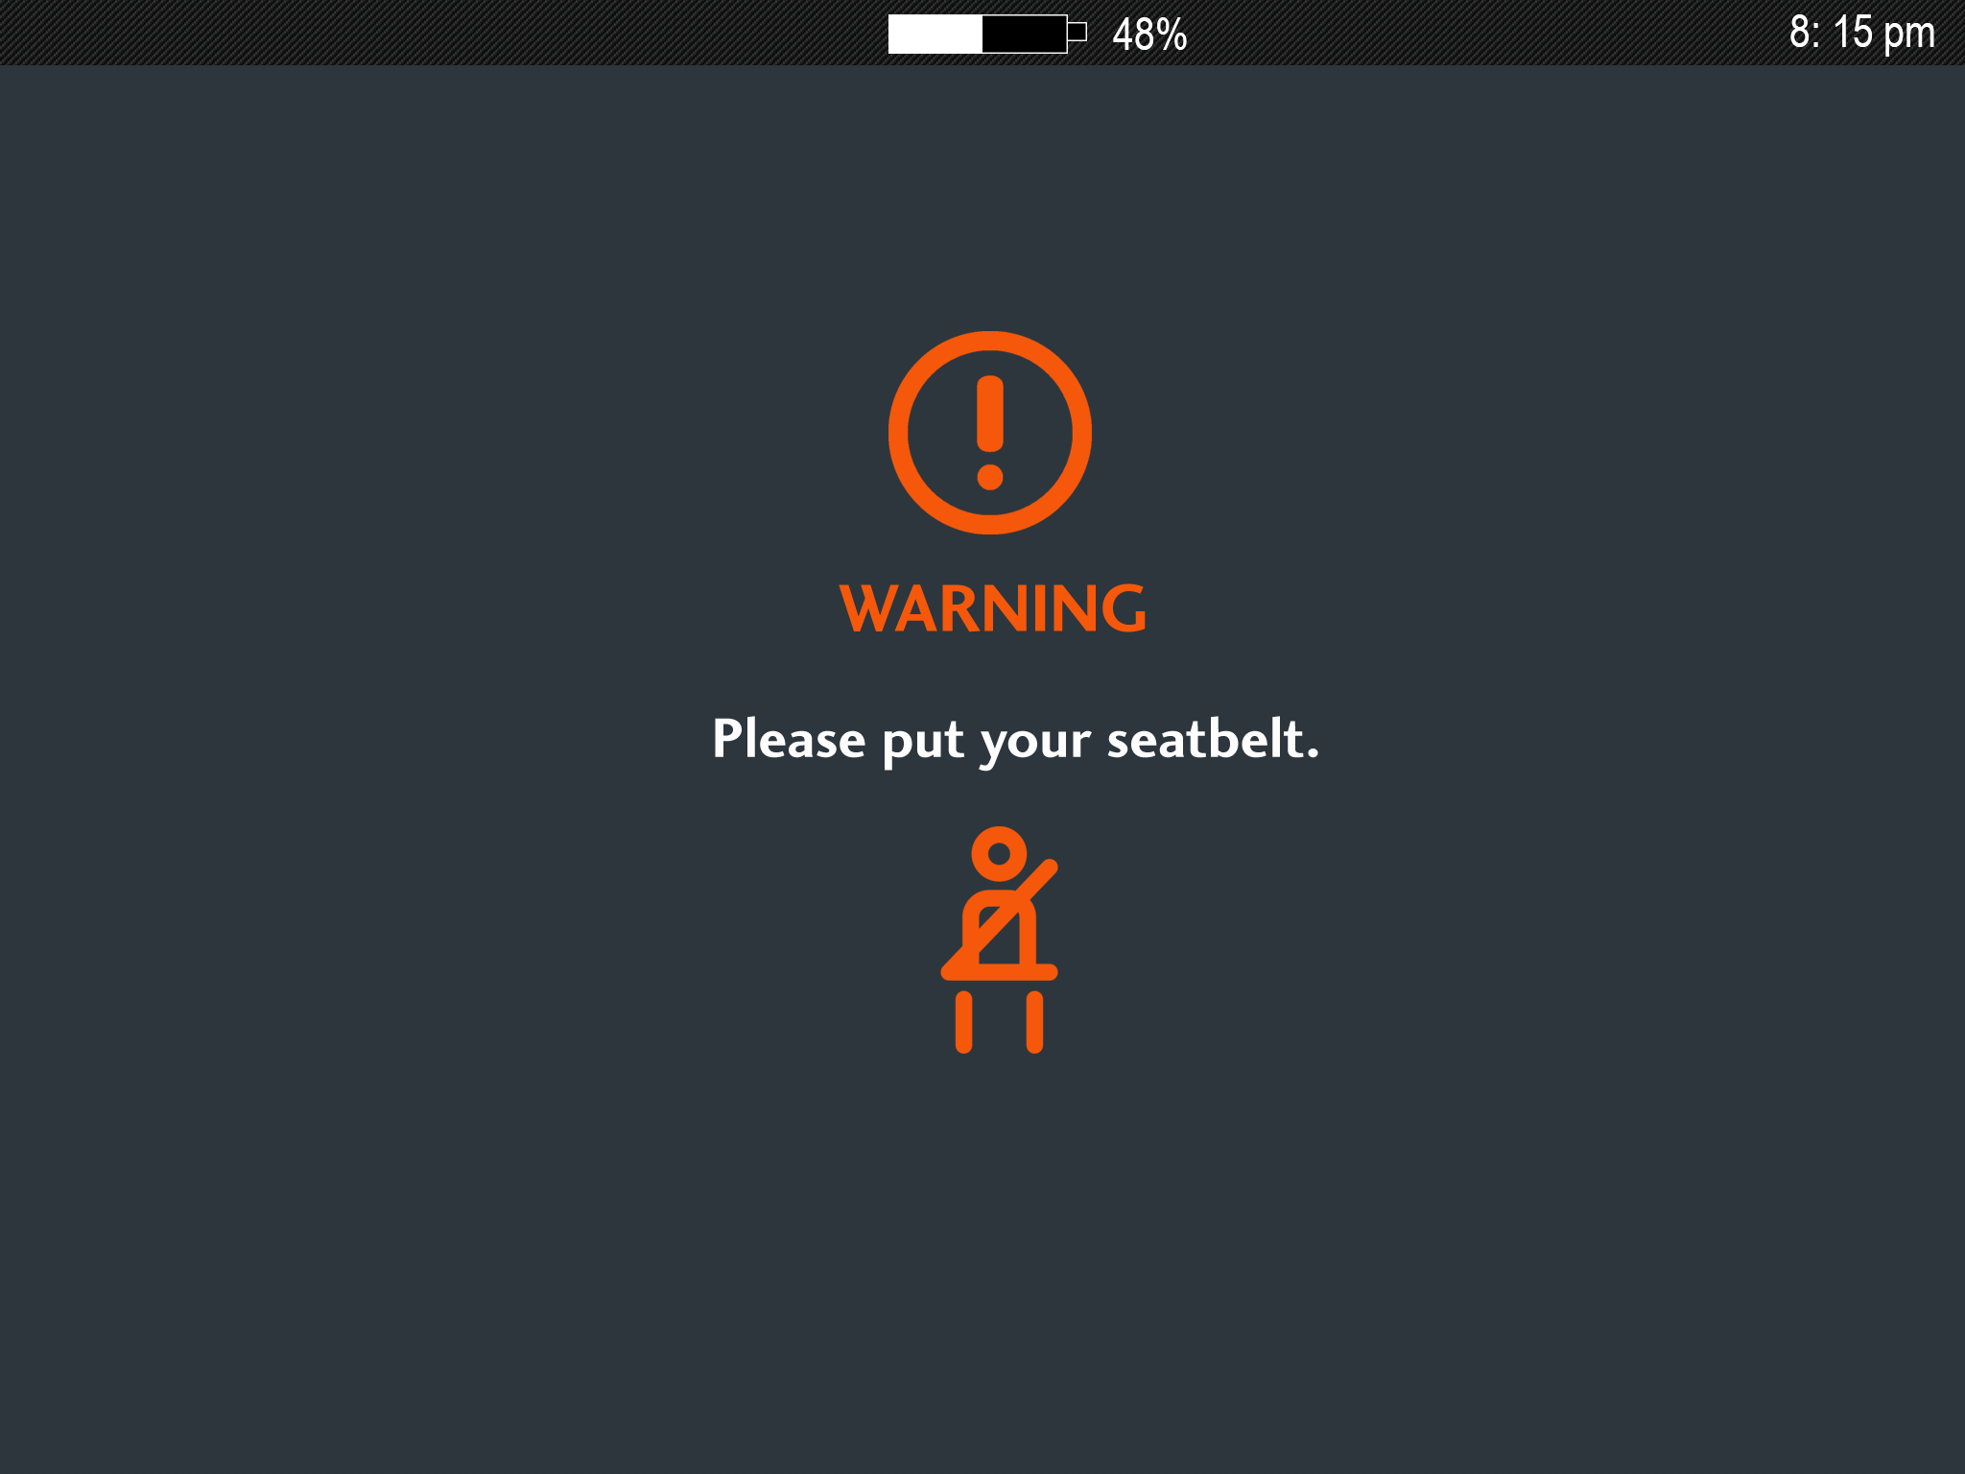

Slide 10
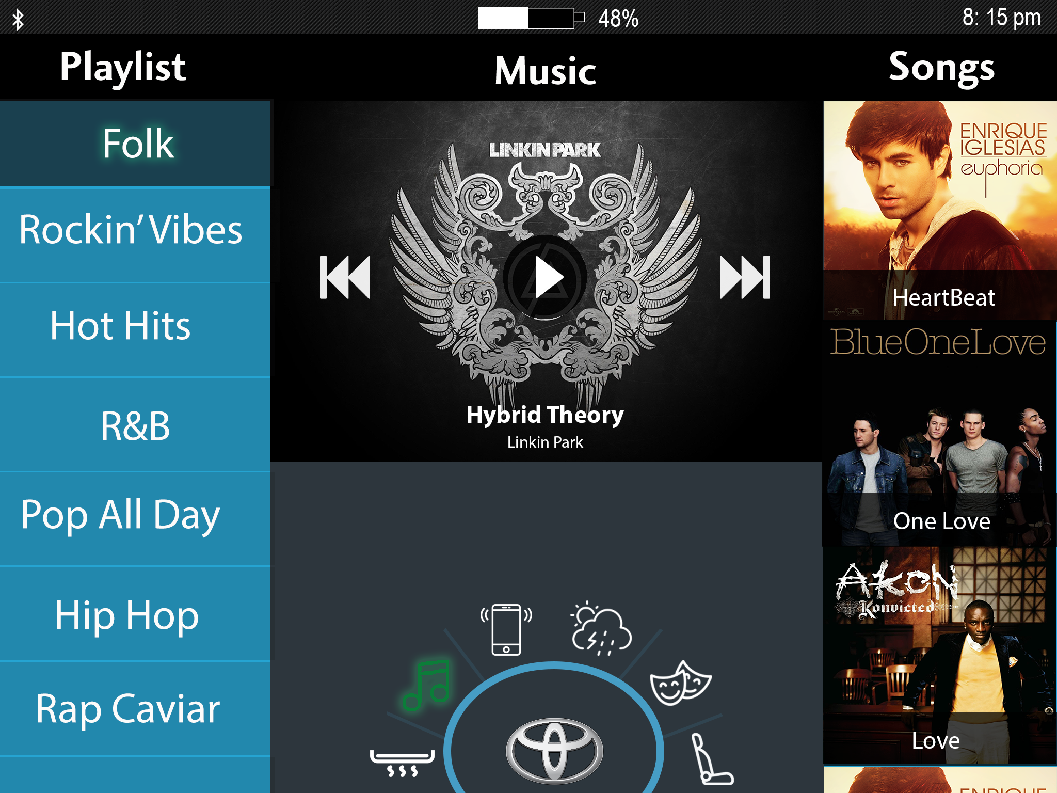

Slide 11
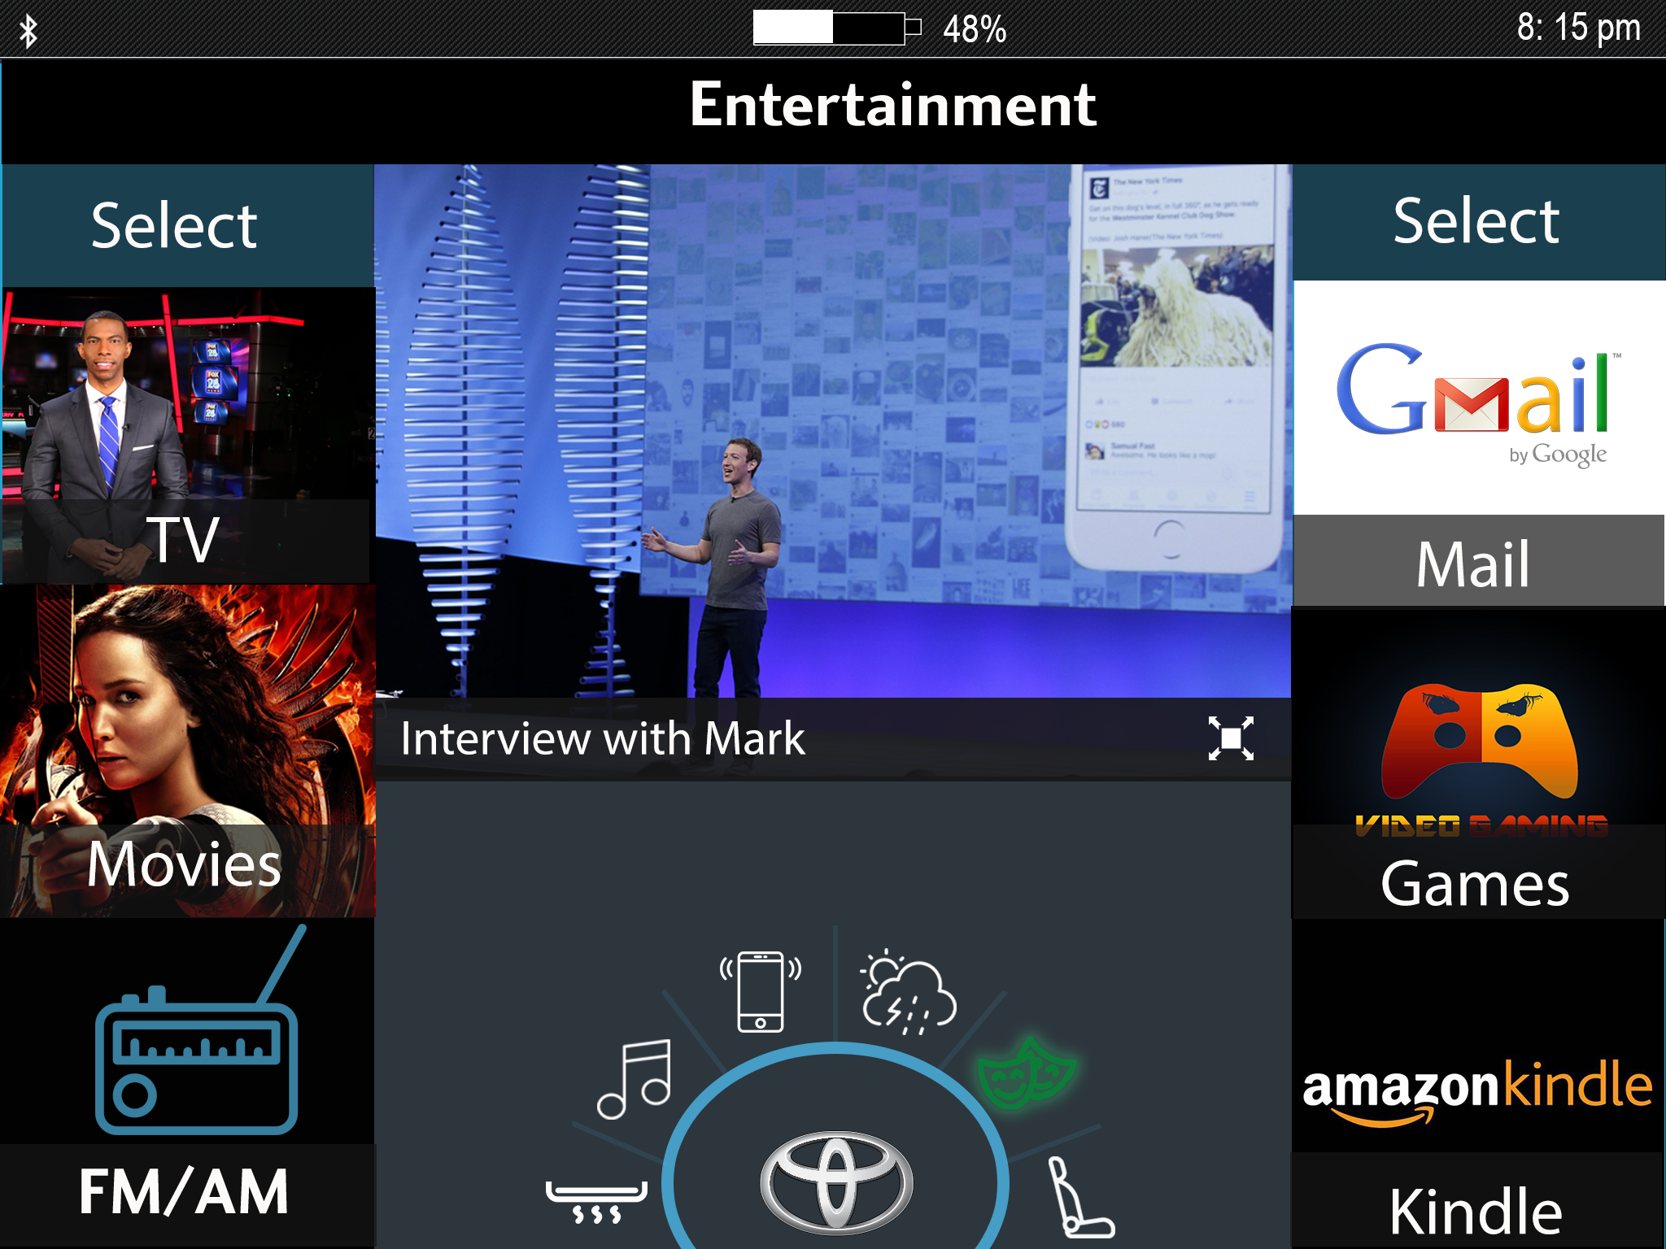

Slide 12
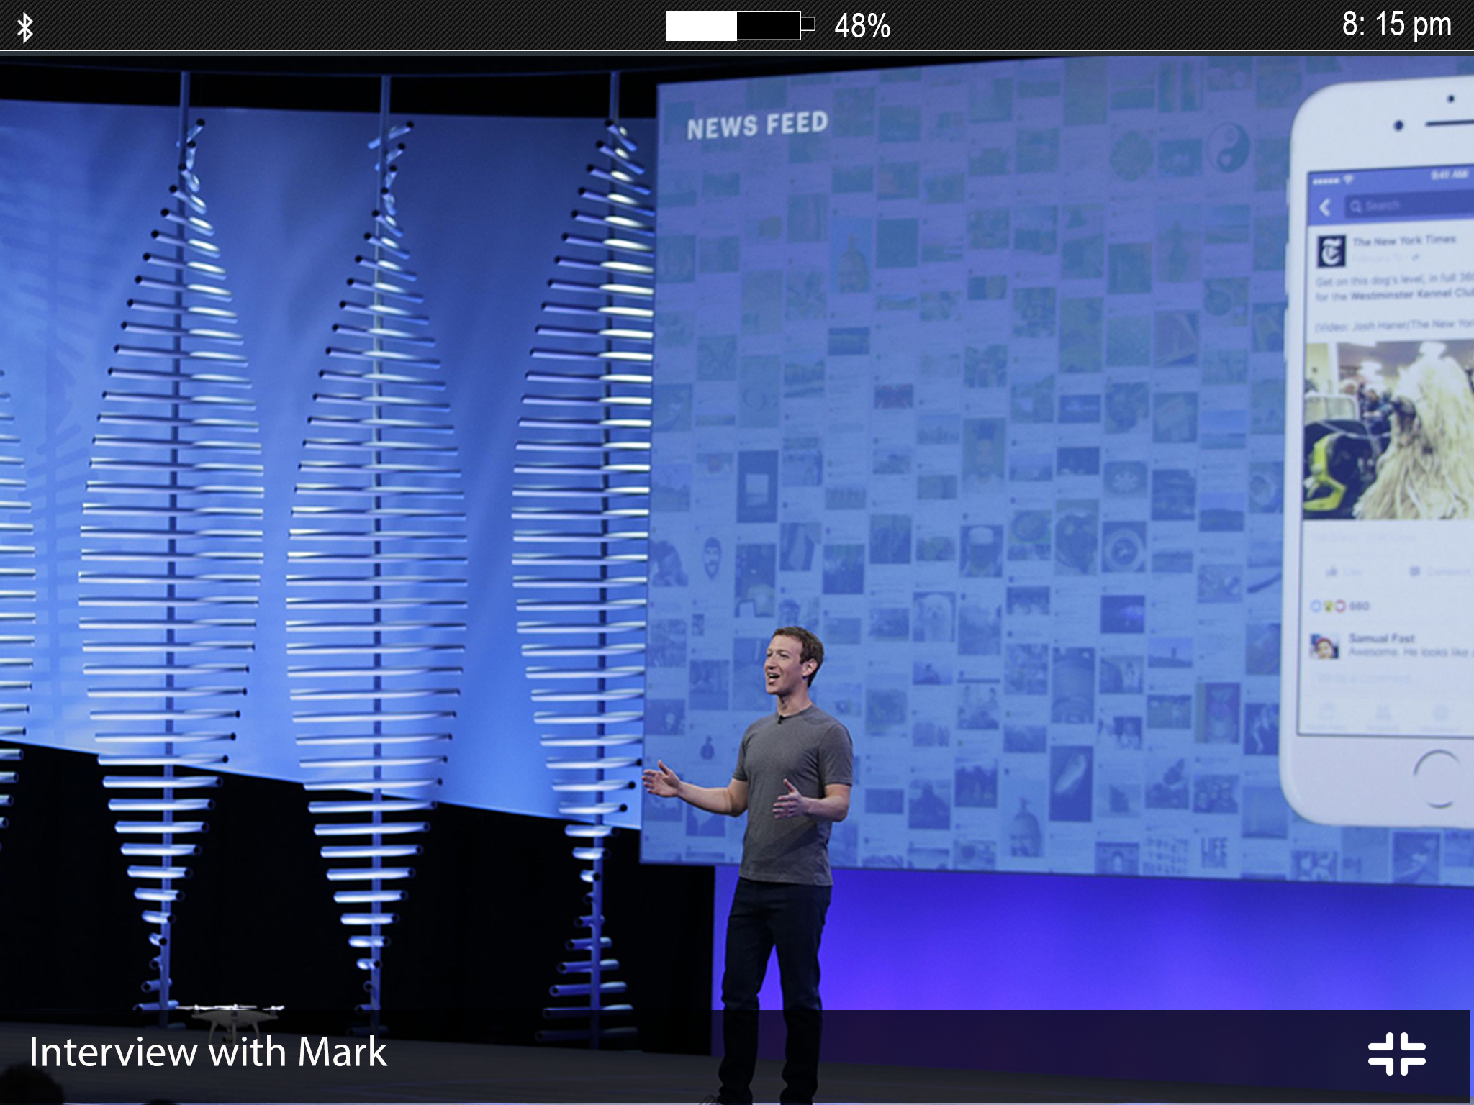

Slide 13
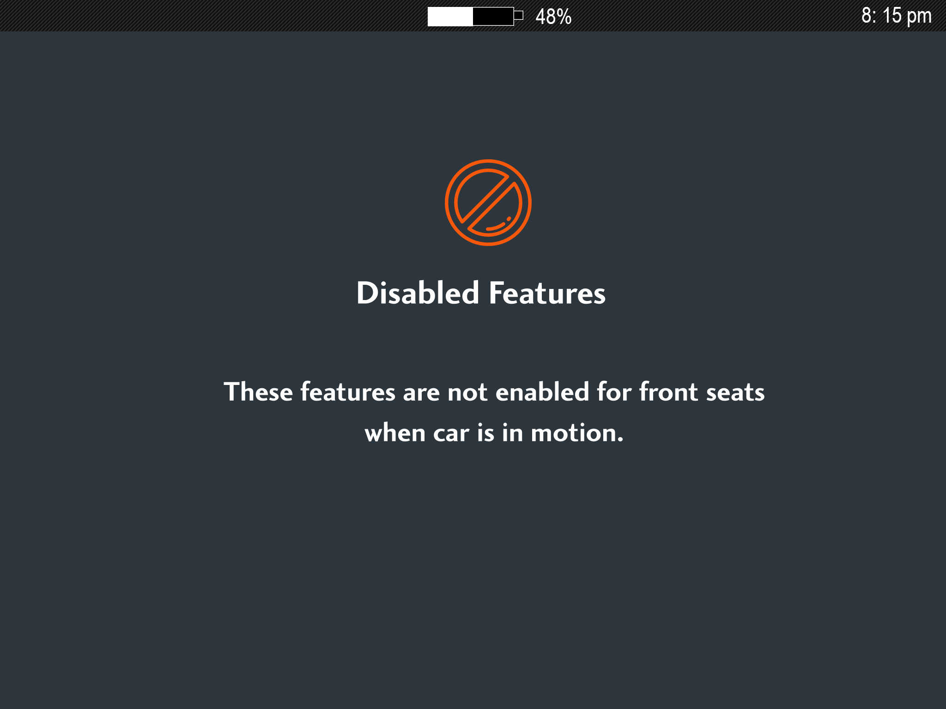

Slide 14
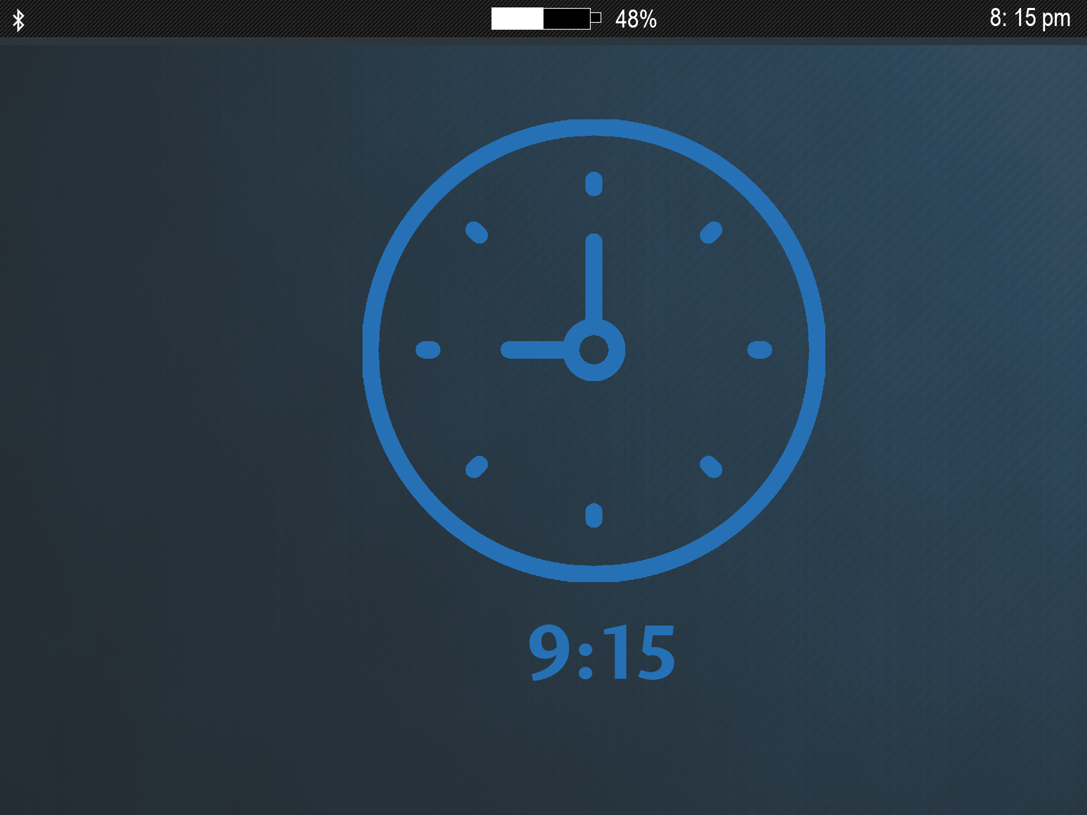

Slide 15
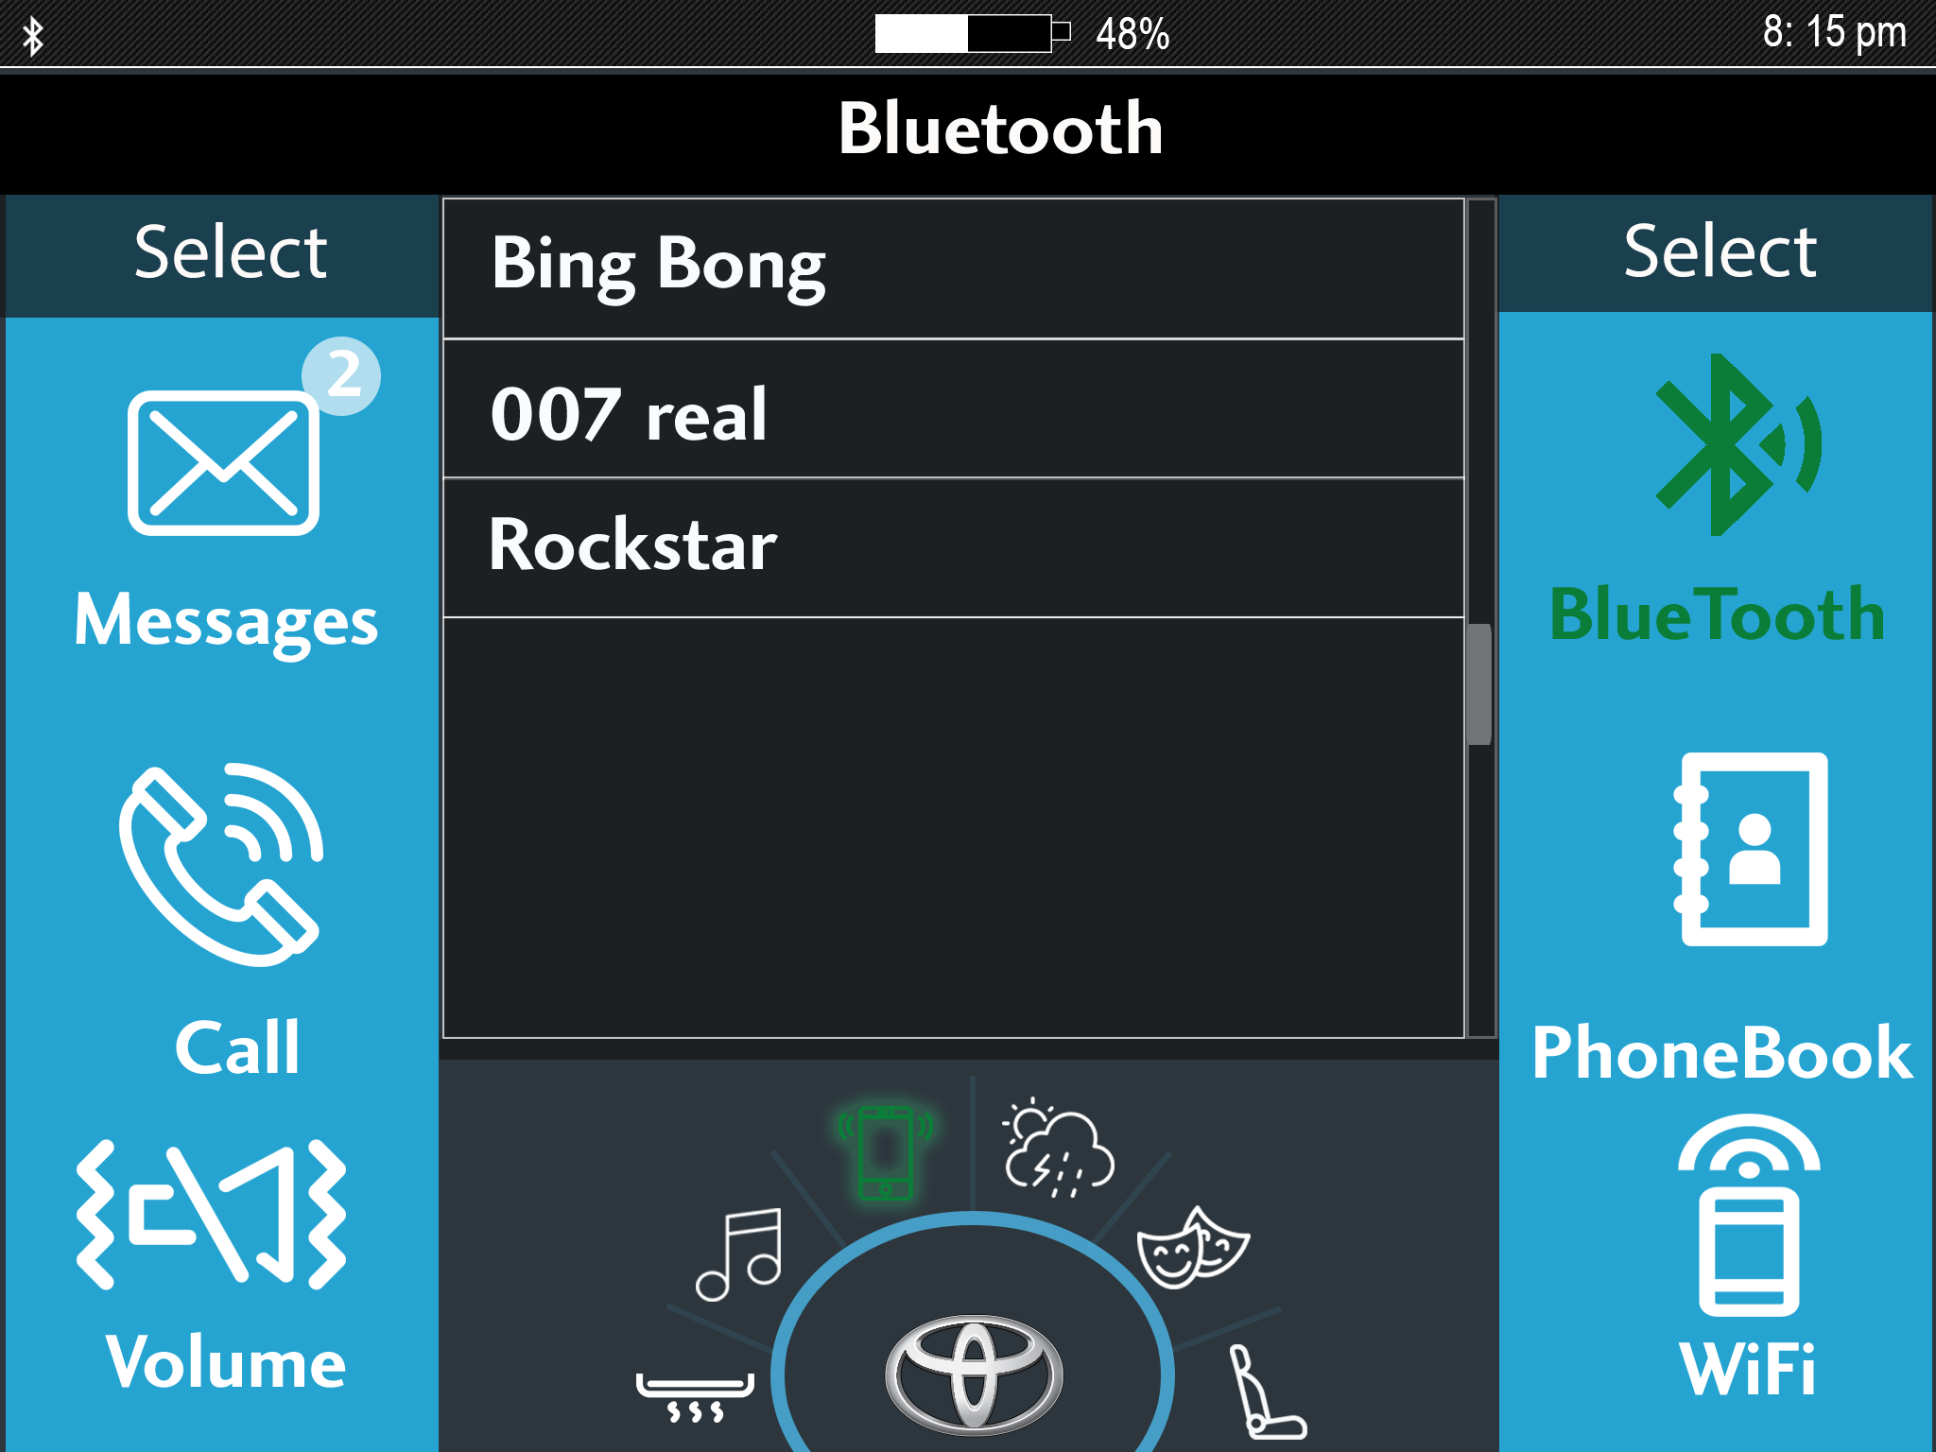

Slide 16
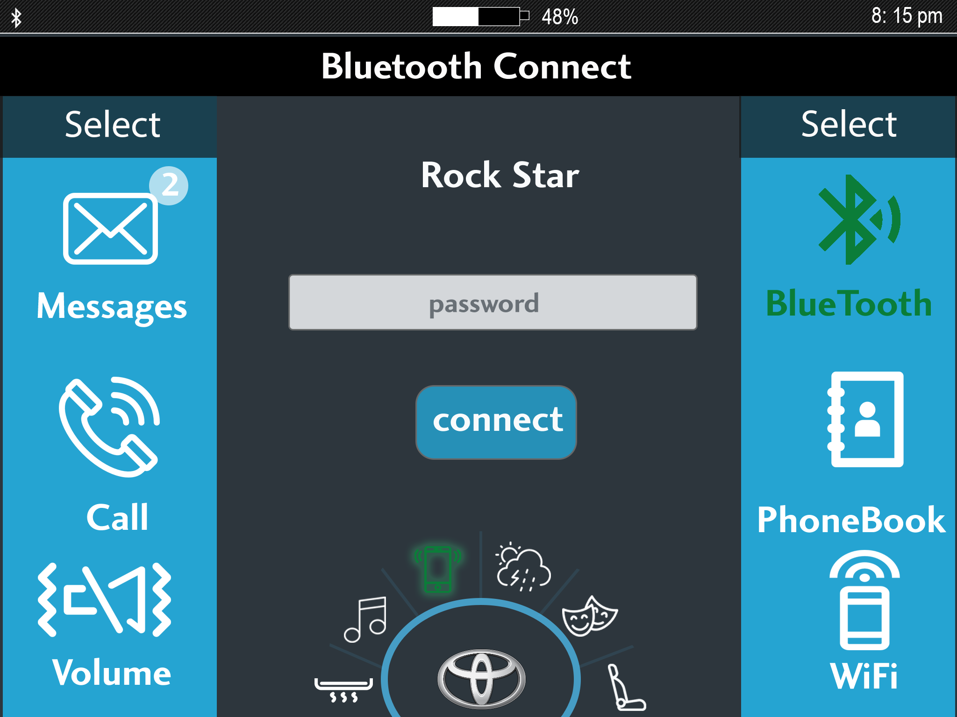

Slide 17
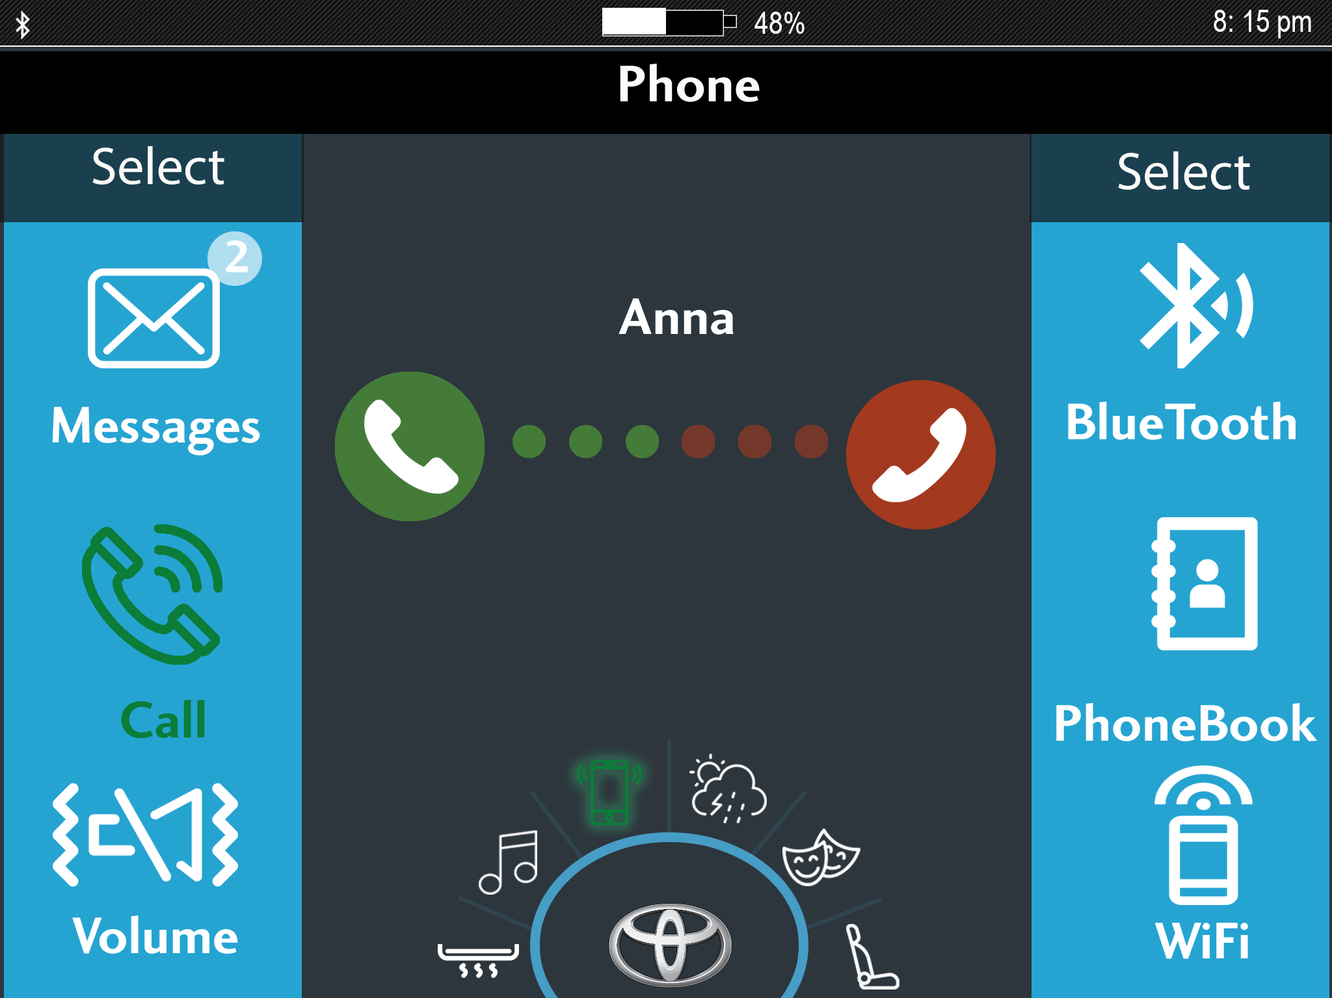

Slide 18
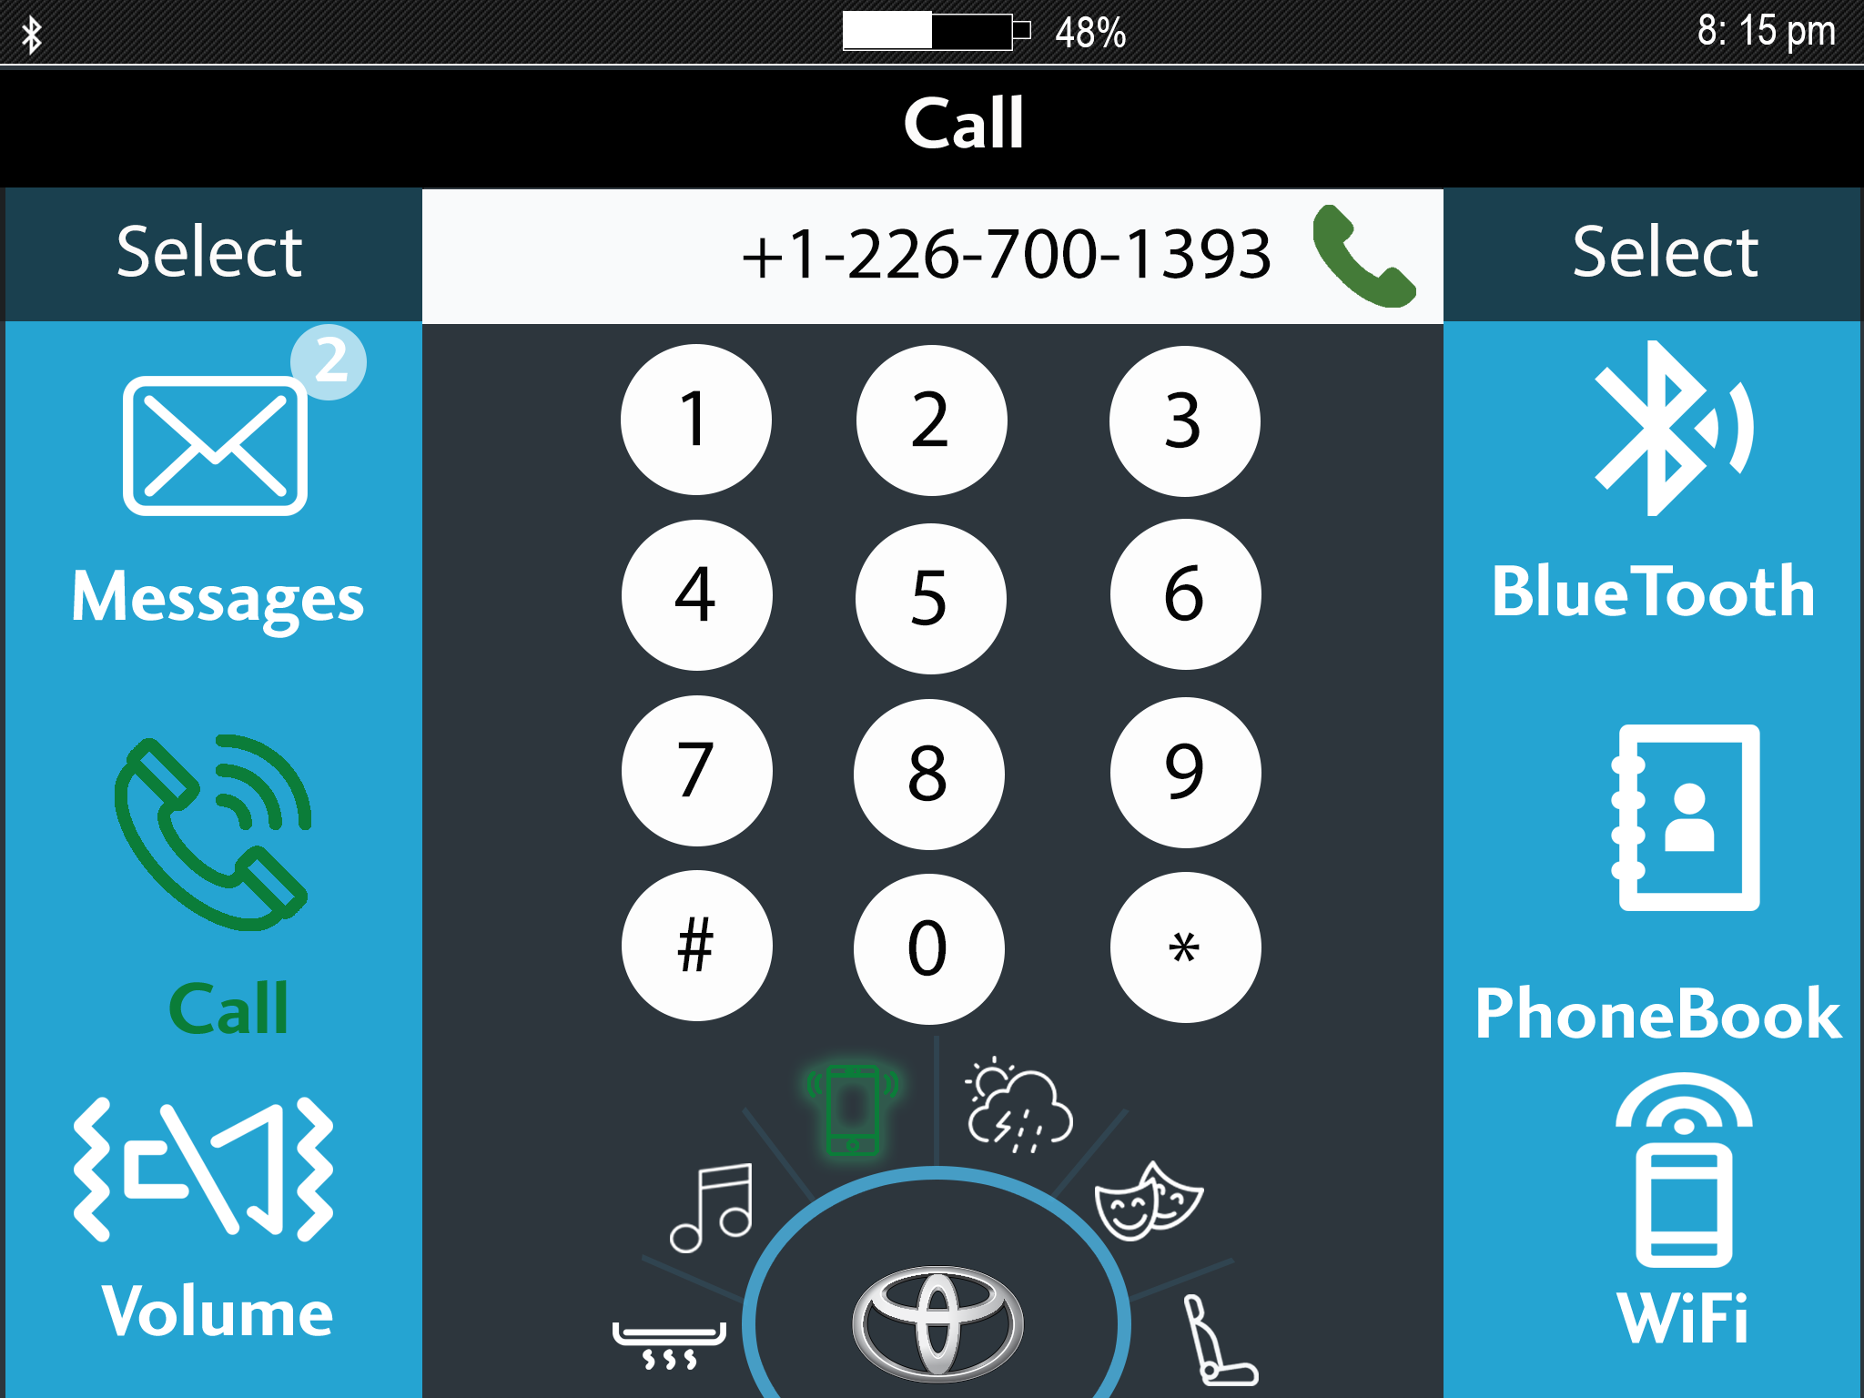

Slide 19
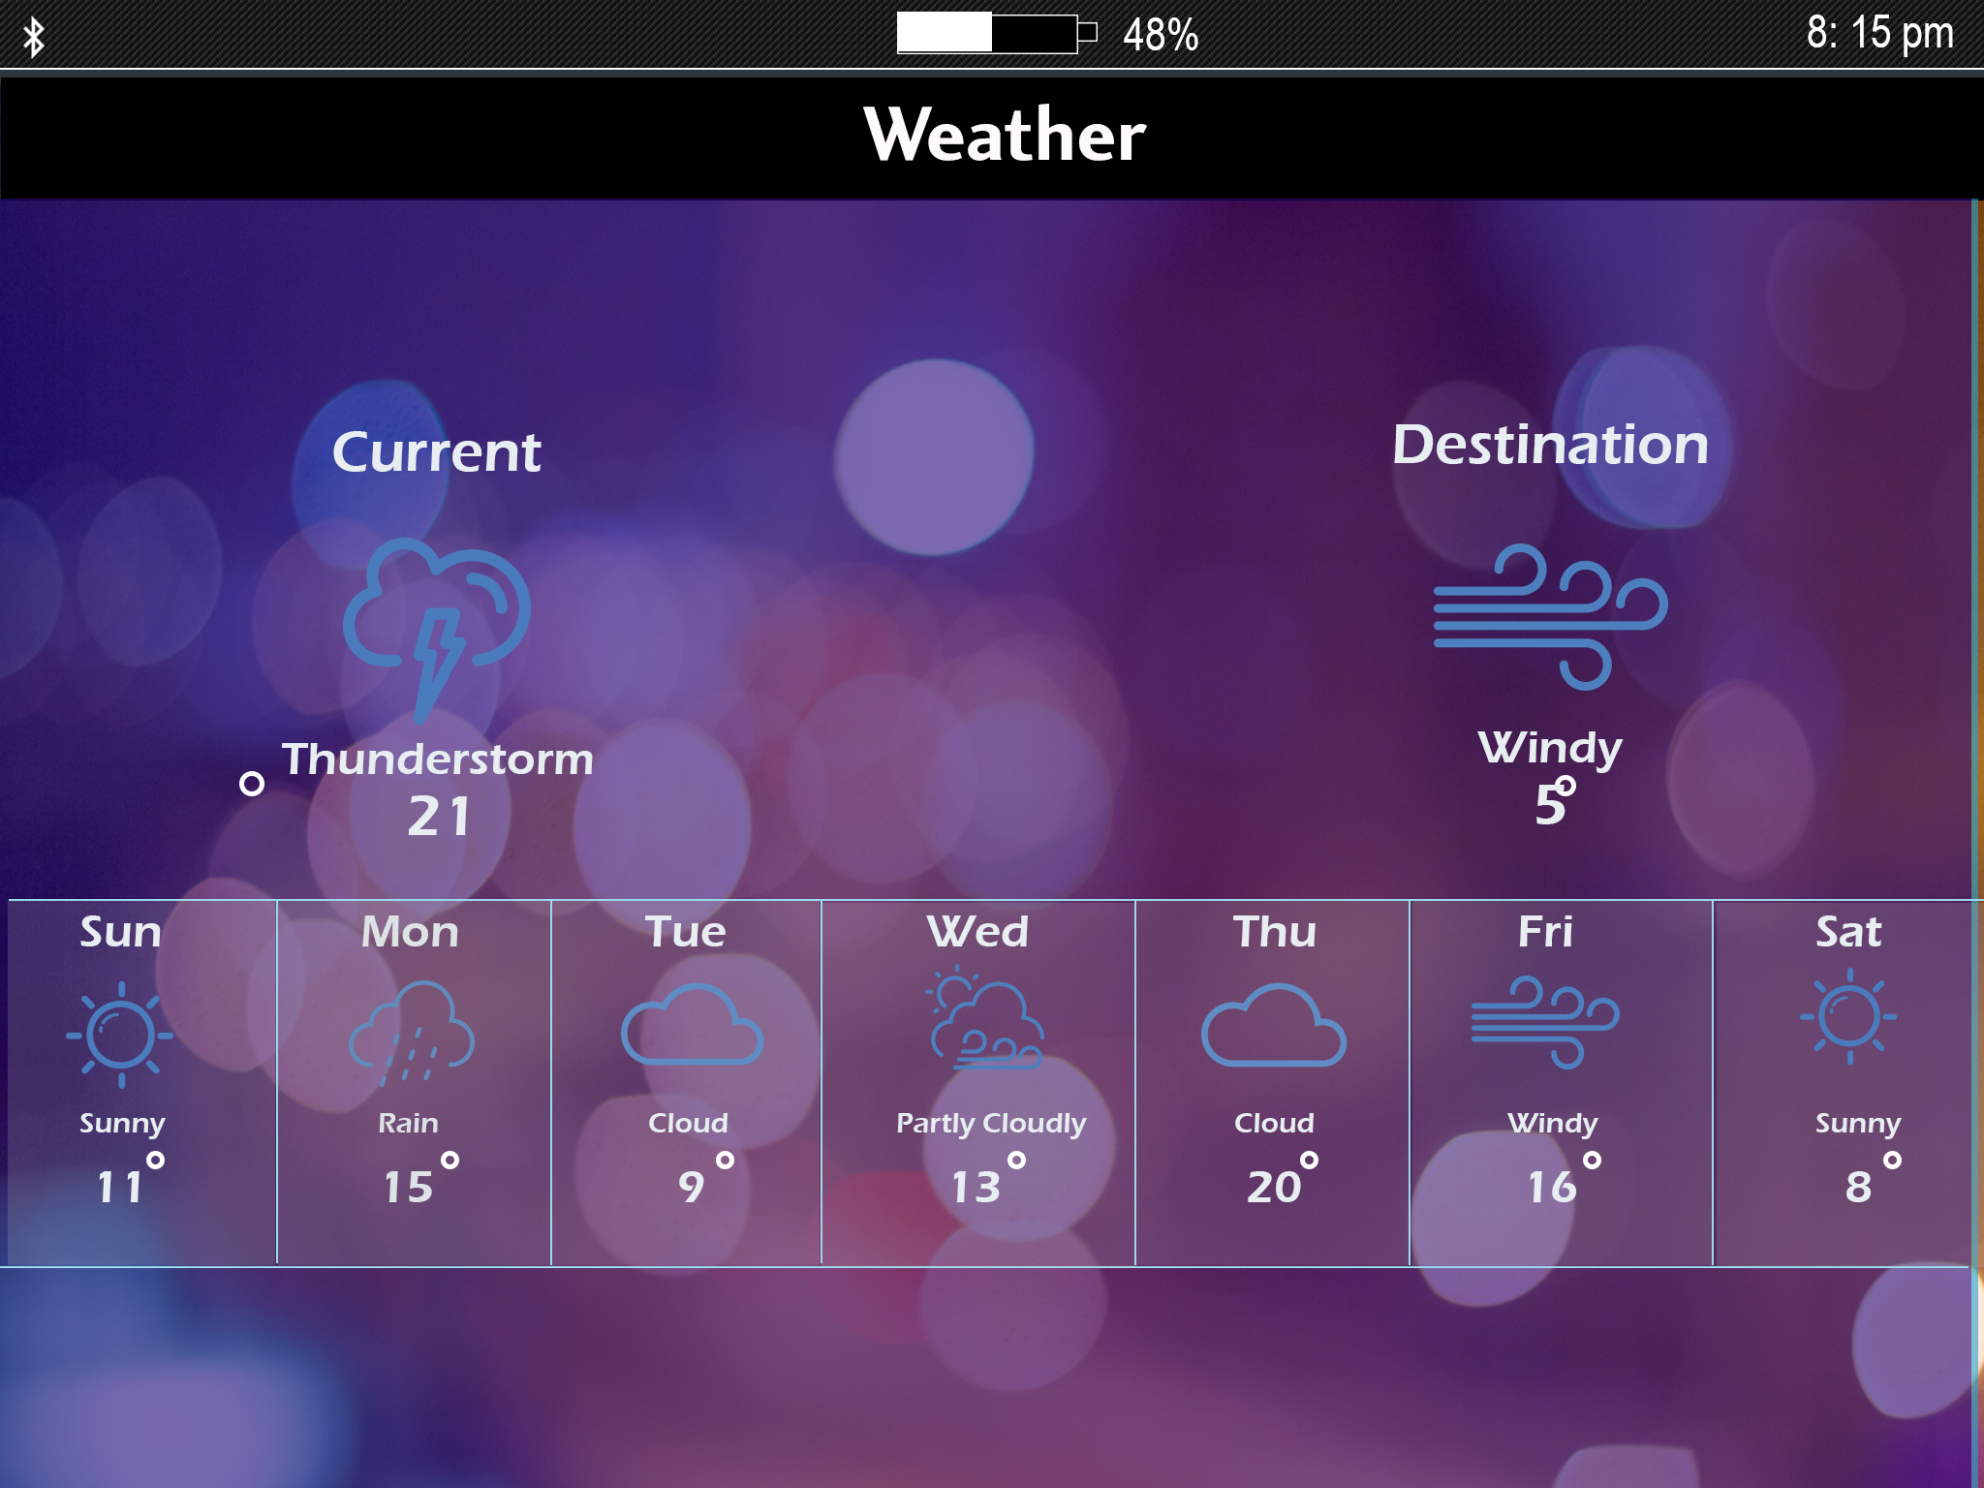

Slide 20
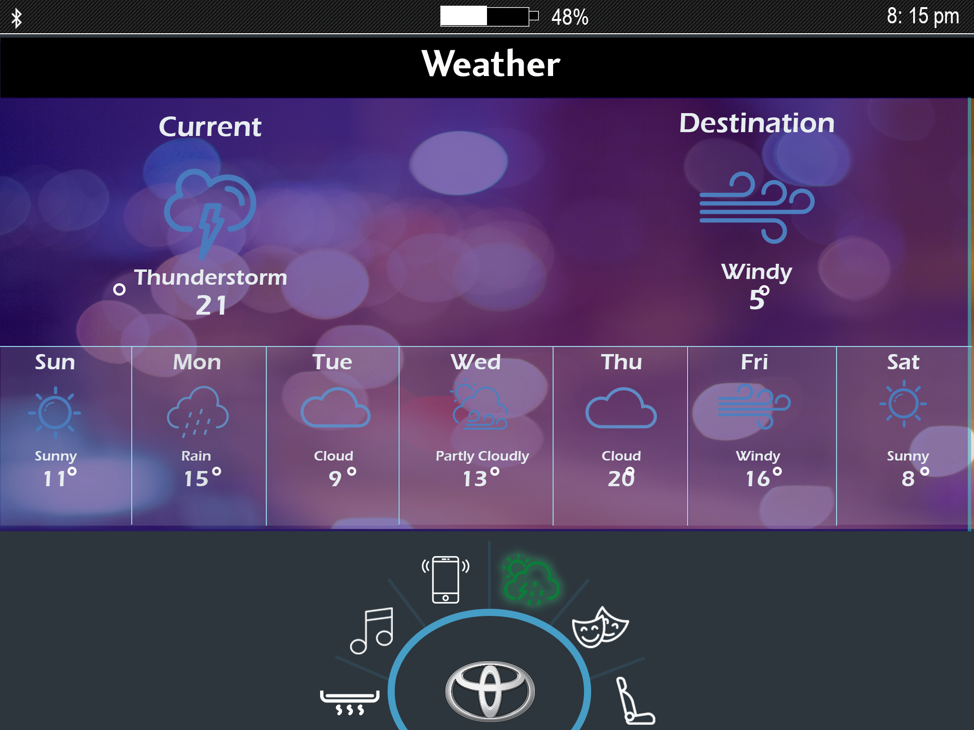

Slide 21
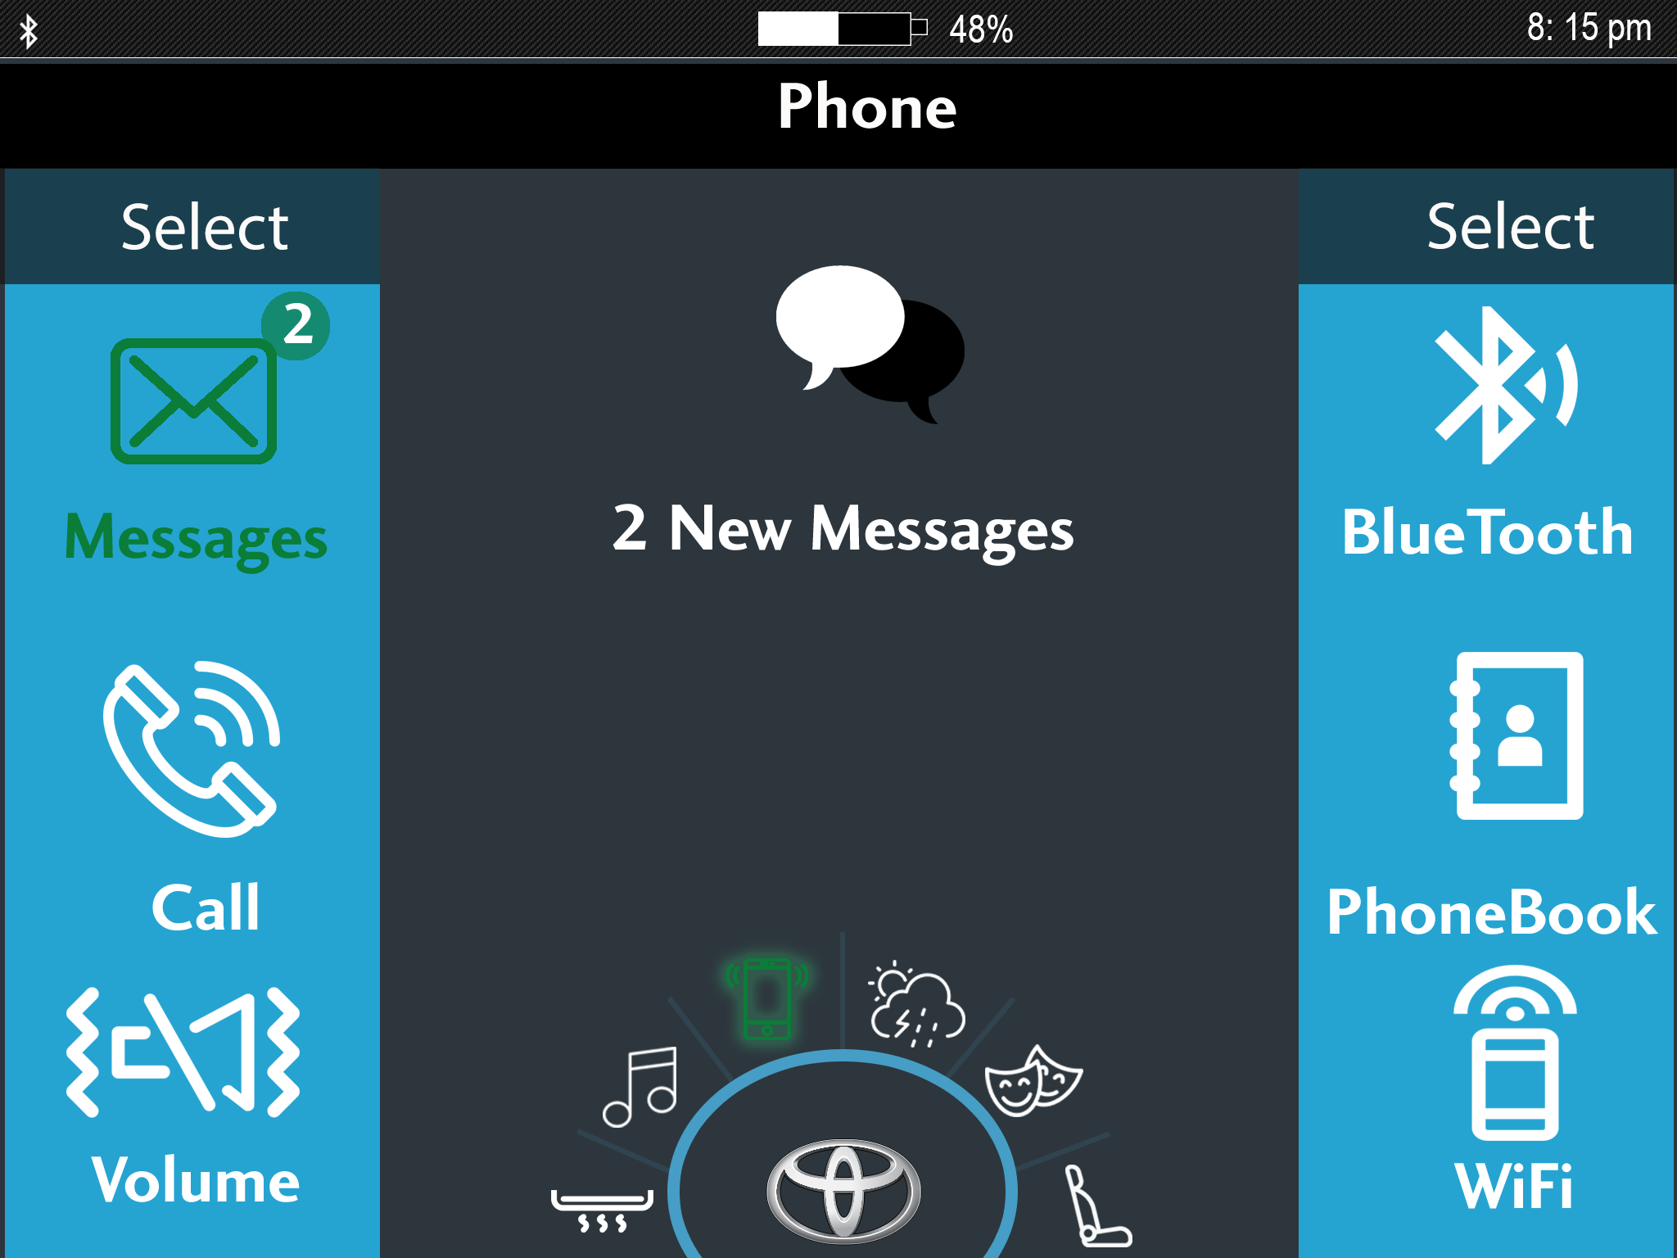

Slide 22
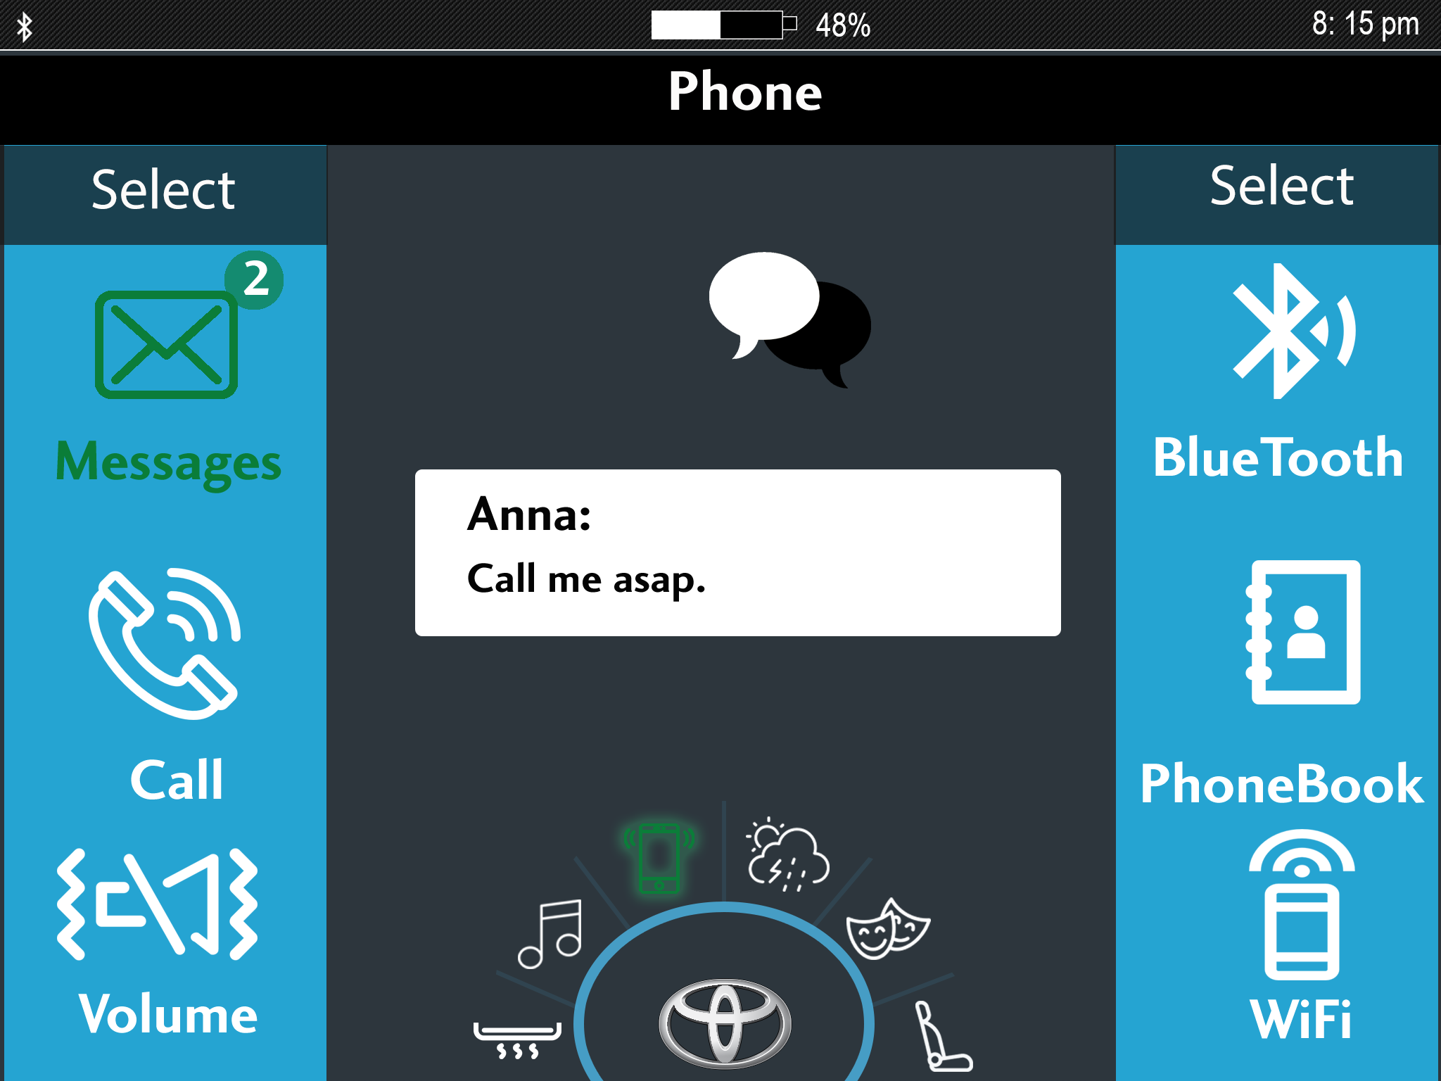

Slide 23
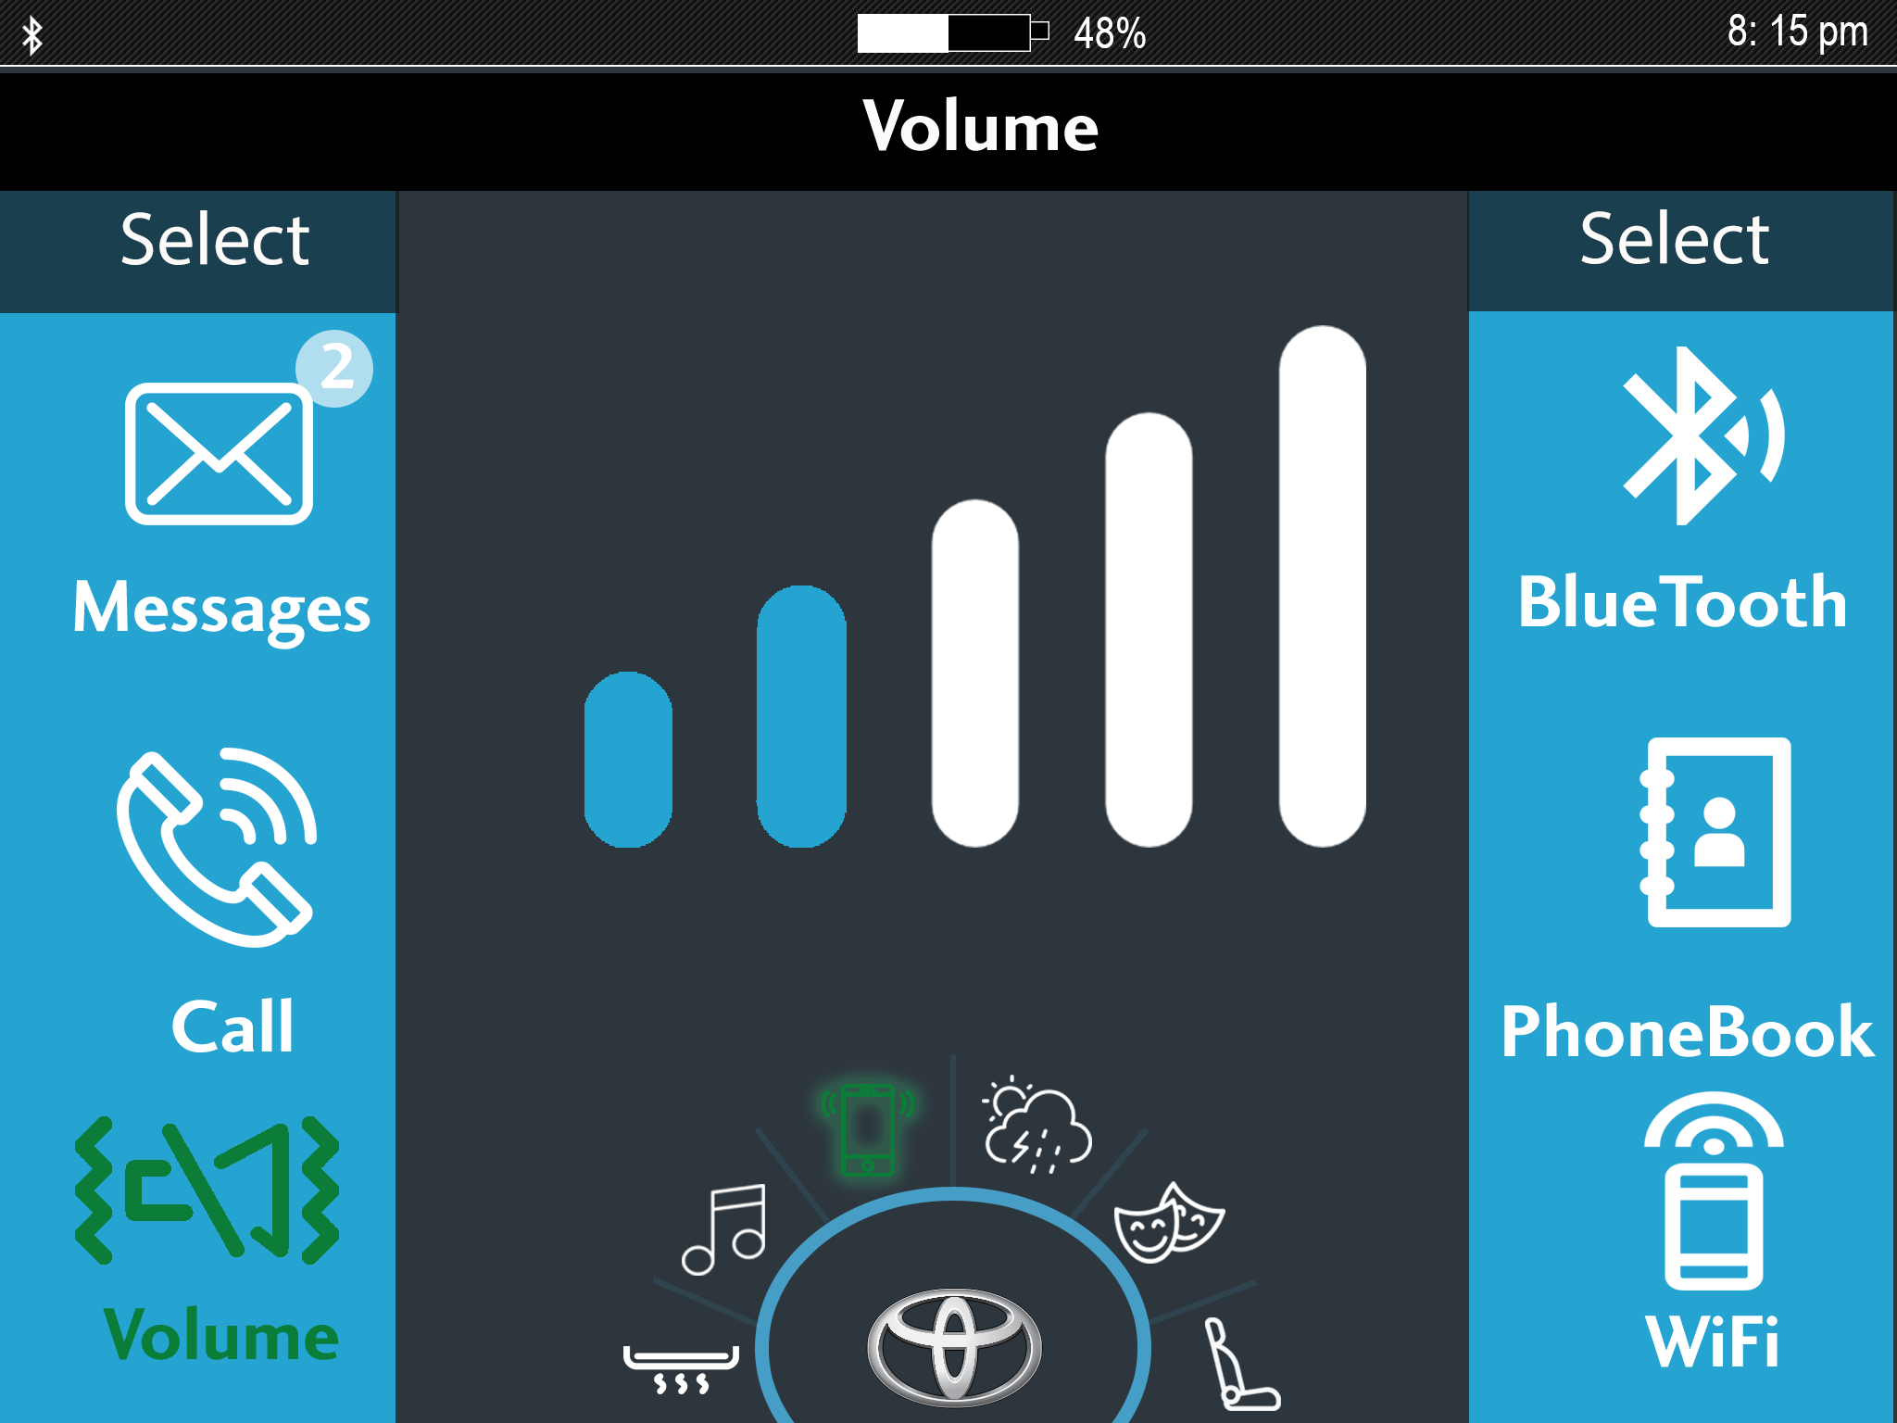

Slide 24
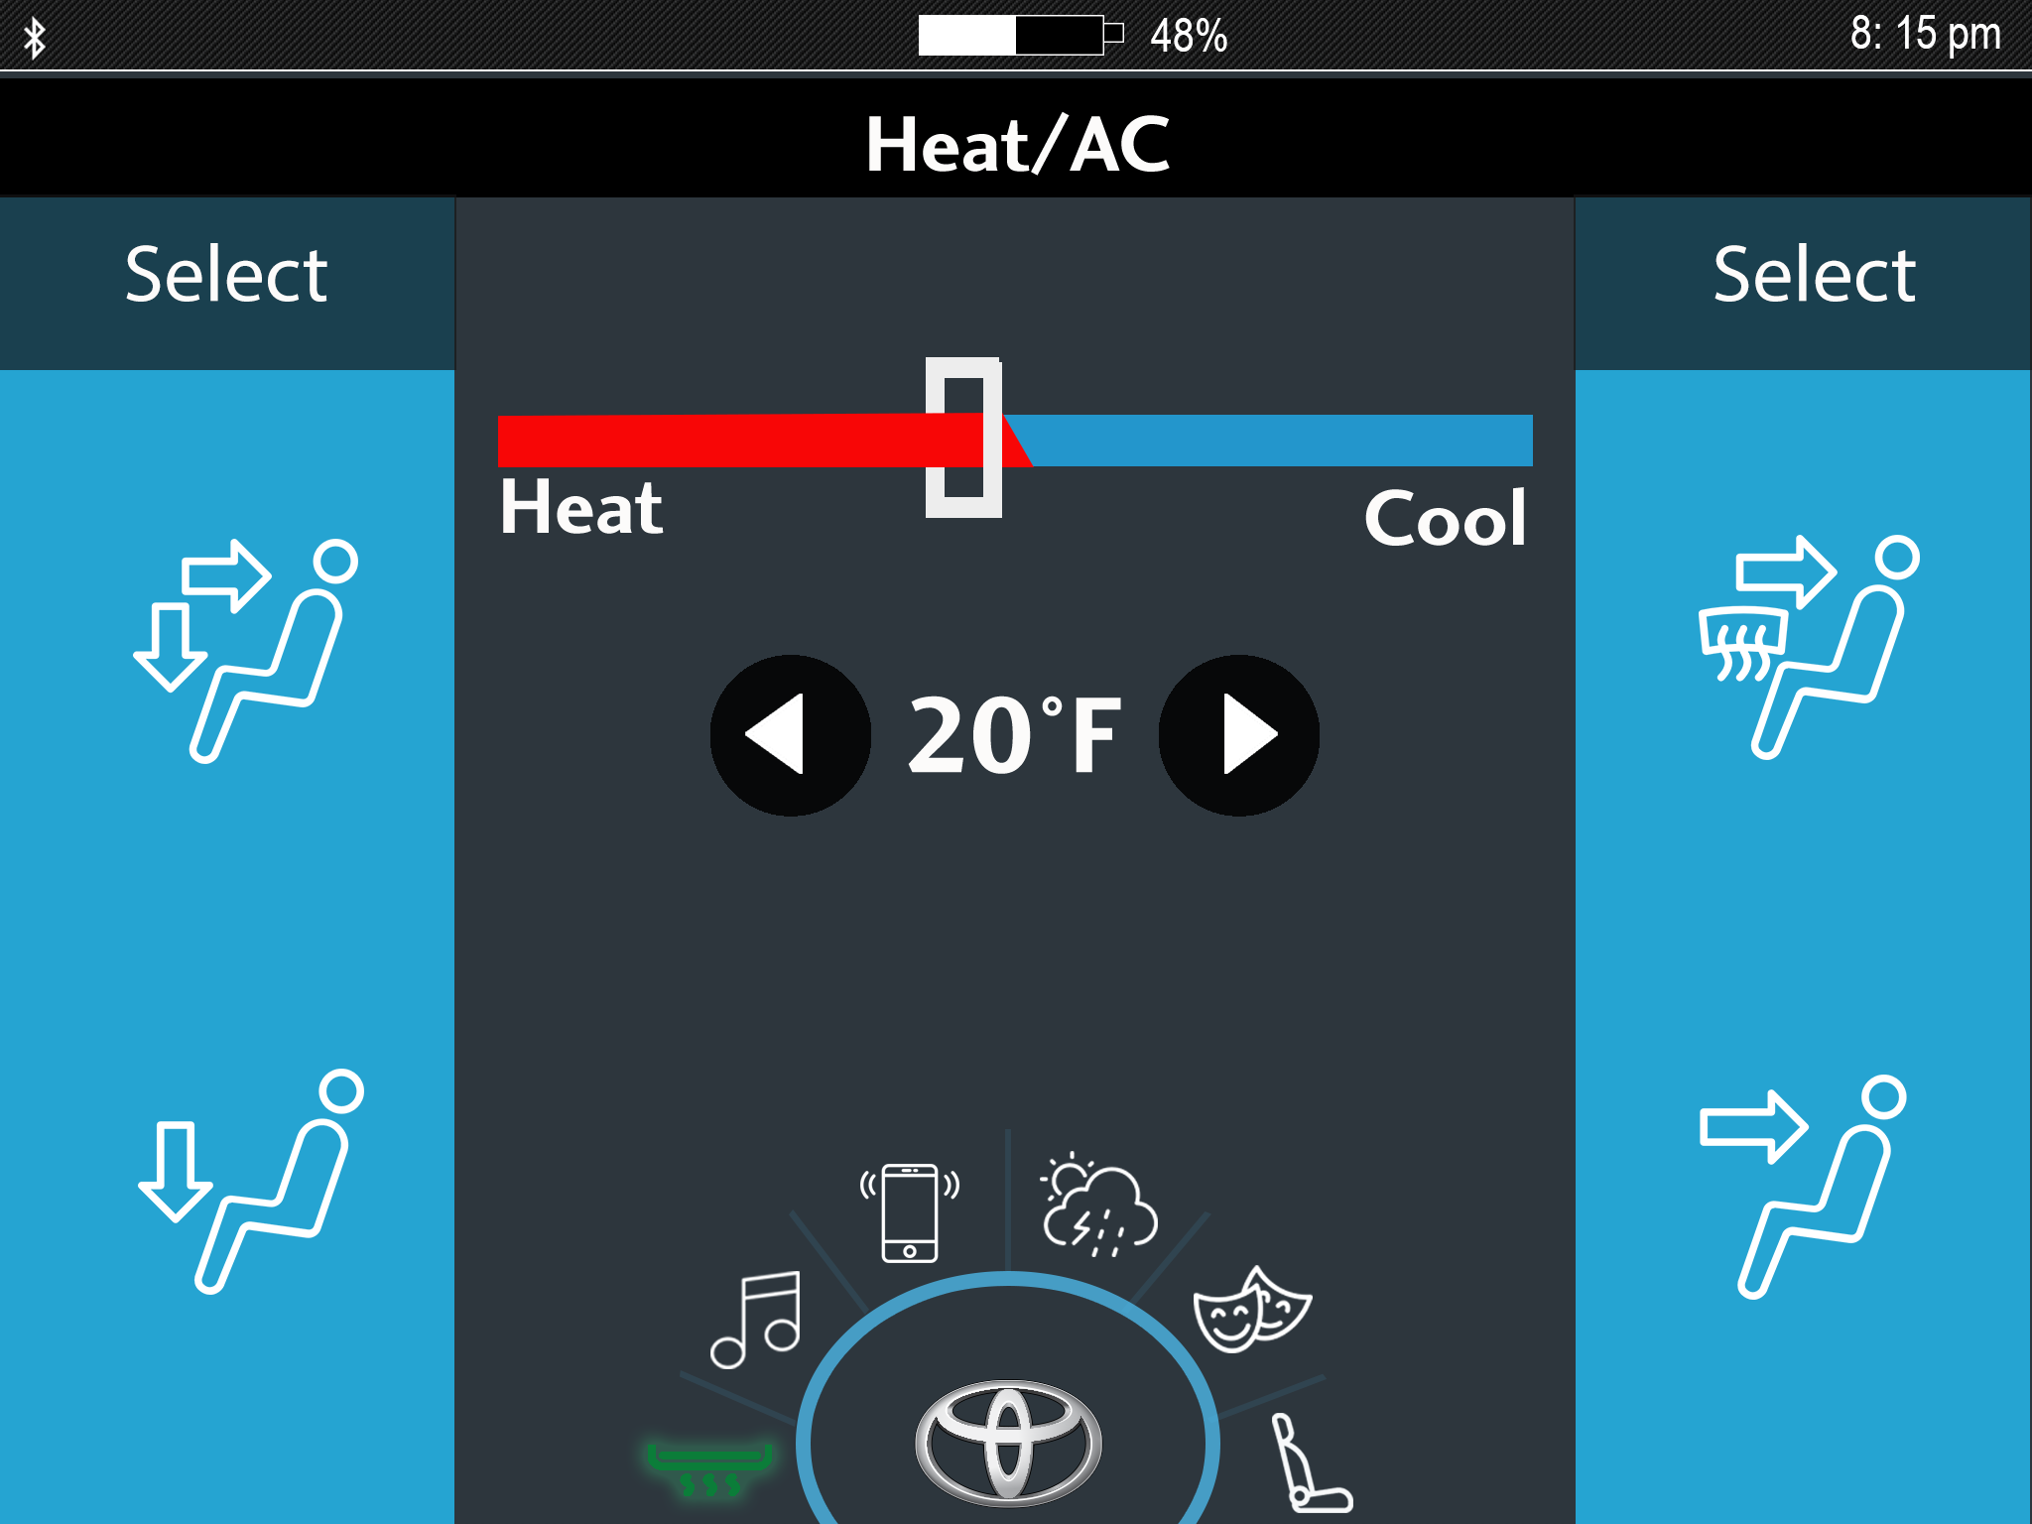

Slide 25
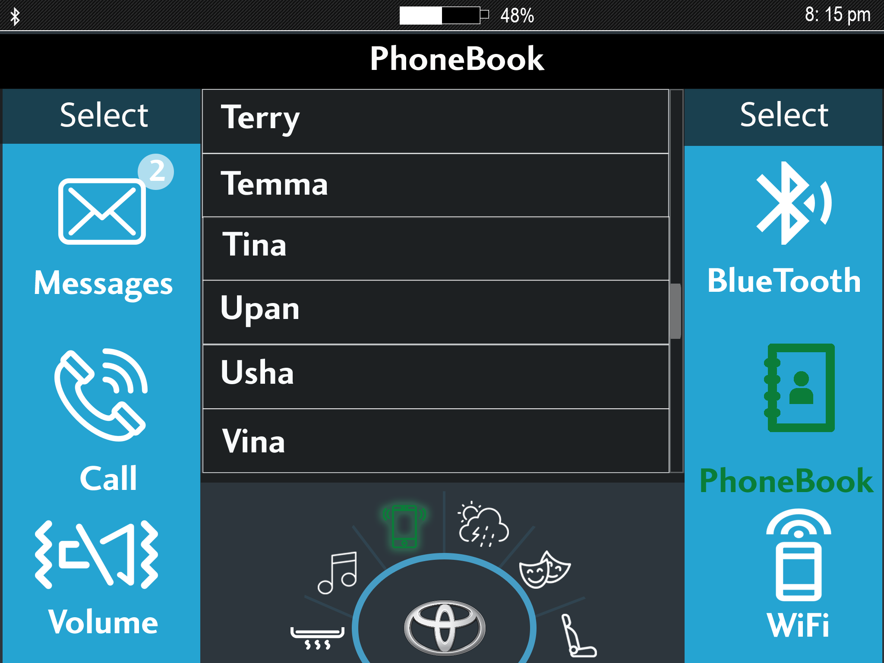

Slide 26
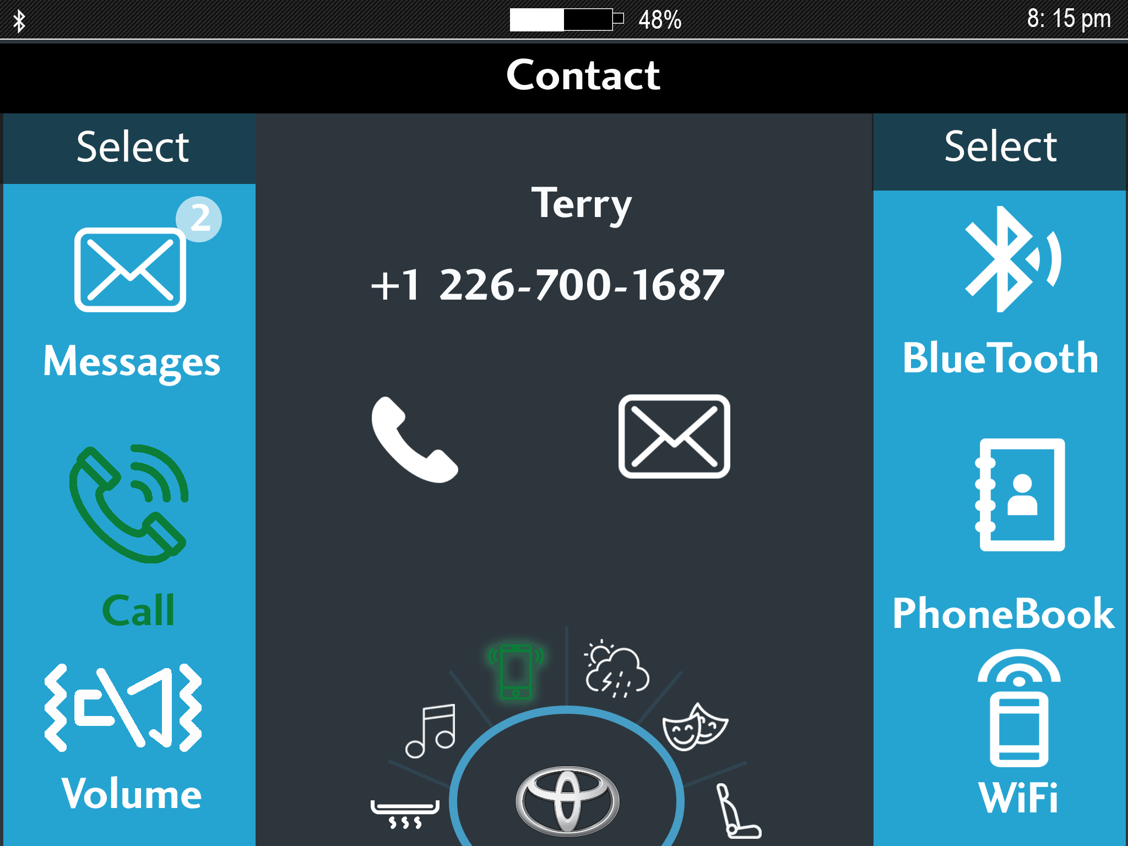

Slide 27
MOBILE APPLICATION

Slide 28

HOME SCREEN

Slide 29

BATTERY

Slide 30

CAR ALARM

Slide 31

HEADLIGHTS

Slide 32

ABOUT CAR

Slide 33

LOCK

Slide 34
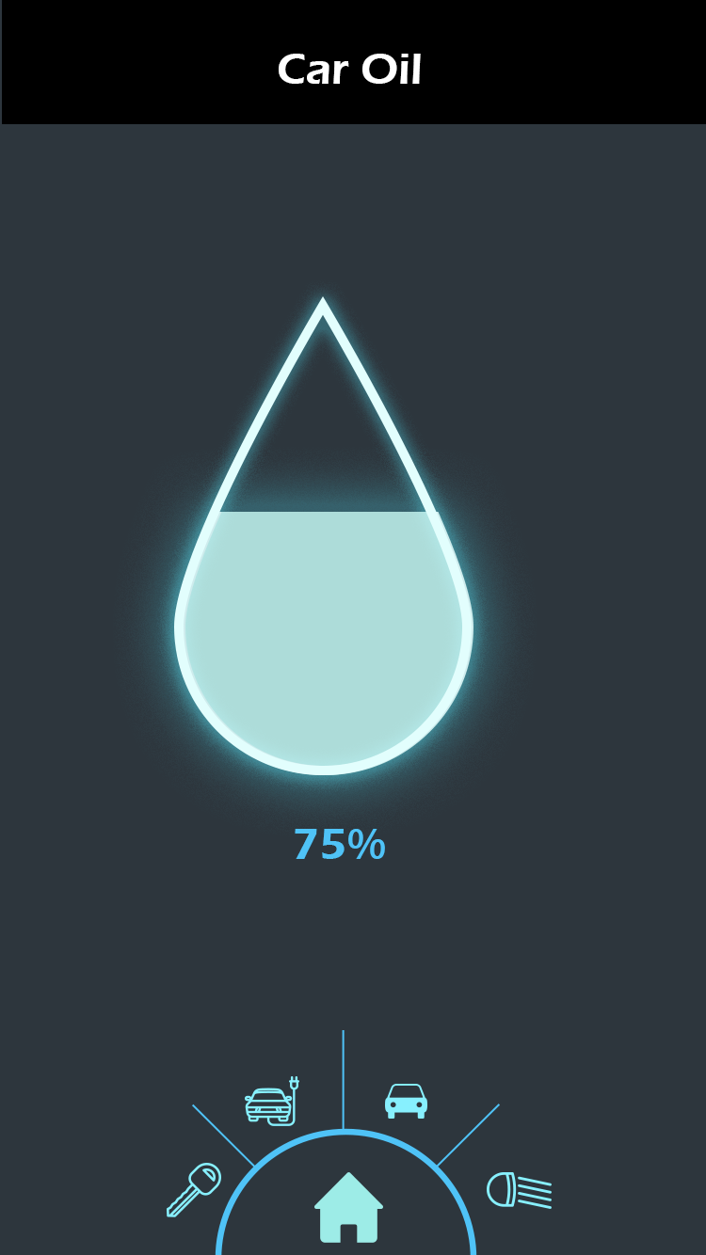
OIL

Slide 35
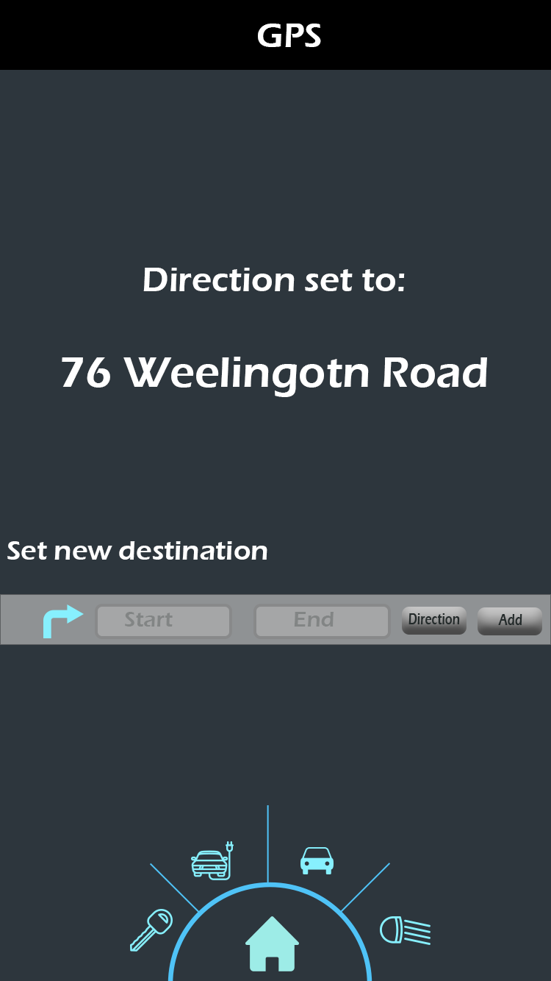
GPS

Slide 36
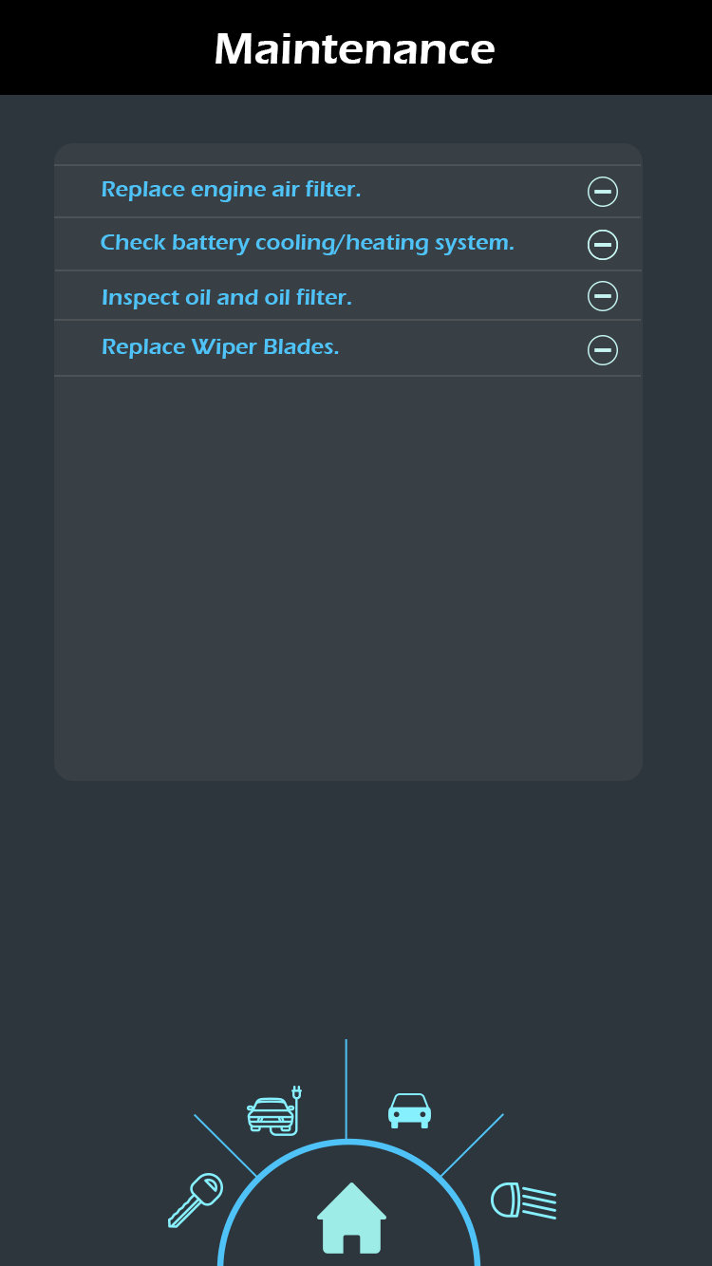
MAINTENANCE

Slide 37
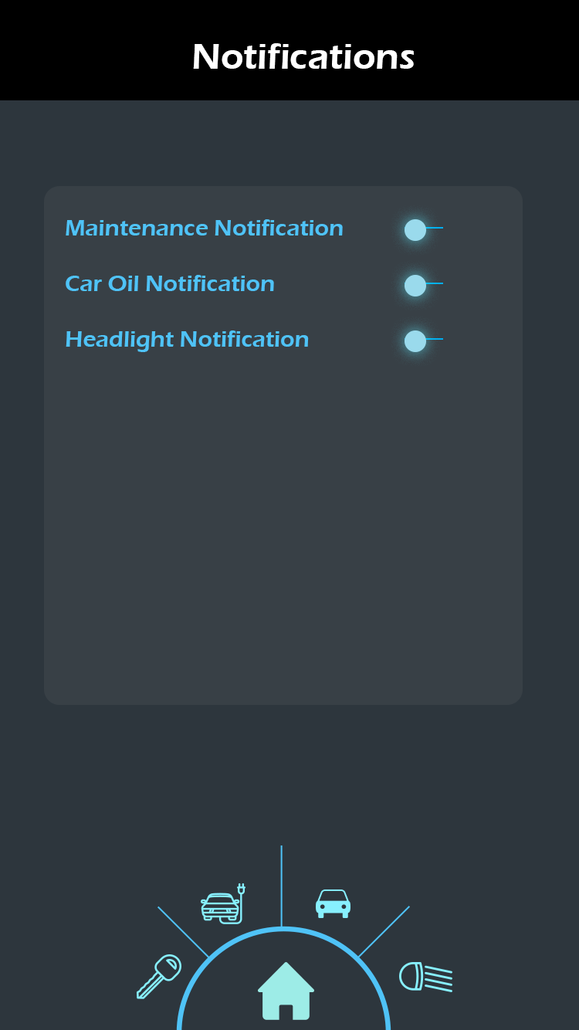
SETTINGS

Slide 38
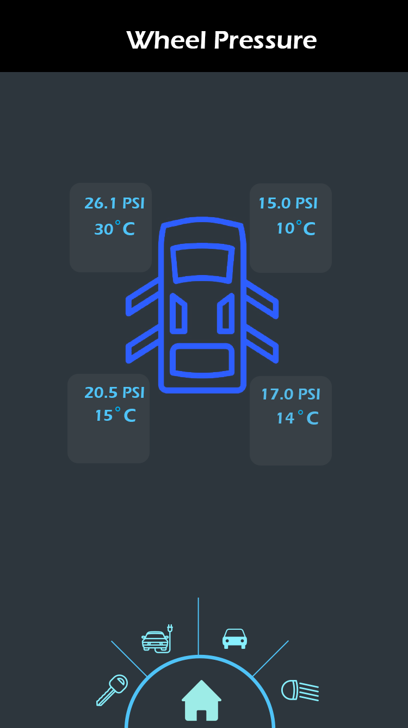
BATTERY

Slide 39
THANK YOU

